Slide 1

Welcome
Working with GoLang Microservices
Notes:
Mandatory
ACTION: Adjust title to fit your course.

Slide 2


Hello
About me...
25+ years in the indusry
20+ years in teaching
Certified Cloud architect
Passionate about learning
Also, passionate about Reese’s Cups!
Allen Sanders
with DevelopIntelligence, a Pluralsight Company.
Notes:
Mandatory
ACTION: Adjust objectives to fit your course.
Script: I am [insert name] with DevelopIntelligence. We’re the training partner for [insert client name]. [Provide brief info on your background.]
Wing it!!! Keep it short!!! (Under 2 minutes; less than 1 is even better). Your goal is to establish rapport. You’re just trying to connect with the students. For example...
Here’s a little about my background in case you want this for reference later. Fun fact: [insert a piece of trivia about your personal life…”When I’m not teaching or coding, I am a skydiver”…whatever cool hobby you are engaged in]
Avoid putting your resume here. Say only a sentence or two about your professional credentials and invite them to ask questions about your background or experiences at any point during the training.

Slide 3
Prerequisites
This course assumes you:
Have at least an intermediate level of experience with Go
That experience could be gathered through any combination of previous courses, personal experience, or both
Notes:
Mandatory
ACTION: Adjust prerequisites to fit your course. Keep it brief.
Script: Before we start, I want to make sure everyone is in the correct class. Take a look at these prerequisites and message me in Chat if you have questions or aren’t sure you’re in the right spot.

Slide 4
Why study this subject?
Go is cool! ☺
Microservices are cool! ☺
Microservices in Go are REALLY cool! ☺ ☺
Notes:
Mandatory
ACTION: Adjust benefits to fit your course.
Examples...
Learning Python will let you….
You’ll be learning Python so that you can work on XYZ project…
Your organization will be using Python in its upcoming digital transformation project...

Slide 5








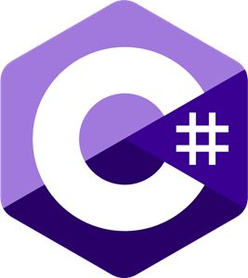
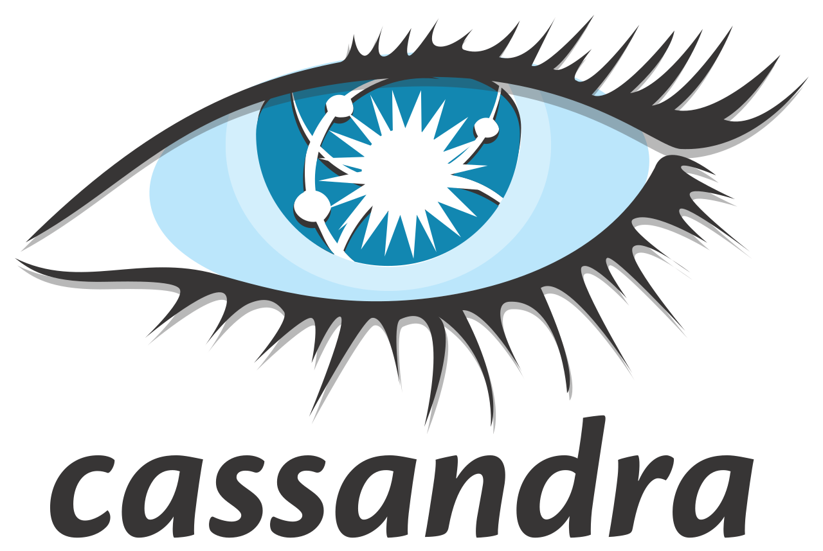

















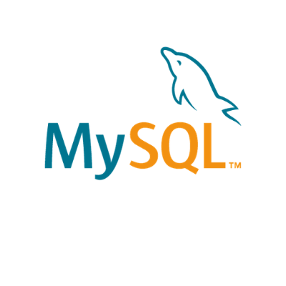





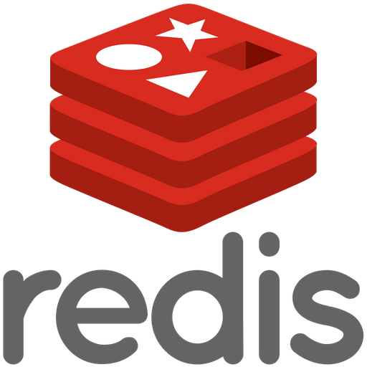




We teach over 400 technology topics
Notes:
Mandatory
Script: DevelopIntelligence teaches a lot of different tech. If there’s a technology you want to learn and you don’t see it in your company’s learning catalog, let your manager know. We’d be glad to help.”

Slide 6



You experience our impact on a daily basis!
Notes:
Mandatory
Script: In your everyday life, you come across tech many times a day. When you shop online. When you pay for your morning coffee. When you watch a movie or travel. We train software developers and IT professionals who work on many of the products and services you use daily.
In fact, when you talk on the phone, watch a movie, connect with friends on social media, drive a car, fly on a plane, shop online, and order a latte with your mobile app, you are experiencing the impact of our solutions.

Slide 7
My pledge to you
I will...
Make this interactive
Ask you questions
Ensure everyone can speak
Use an on-screen timer
Notes:
Mandatory
Script: This is my pledge to you. I’d like to talk in particular about the third bullet. Sometimes in a class, an enthusiastic participant will want to speak out in every discussion, answer every question and so forth. I want to make sure all of you have the opportunity to be heard. So, if I haven’t heard from you in awhile, I may call on you or check in via chat, because I want to make sure everyone gets their questions answered. Also, I want to demonstrate the timer and confirm that everyone can see it. EggTimer is a good timer - https://e.ggtimer.com/

Slide 8
Objectives
At the end of this course you will be able to:
Construct & deploy microservices utilizing Go
Describe the fundamental philosophy around microservices architecture, their benefits, and their cost
Speak to Serverless as well as Containerization deployment models
Notes:
Mandatory
ACTION: Adjust objectives to fit your course.
Use measurable objectives that start with action verbs such as: describe, define, identify, assess, demonstrate, use, utilize. https://elearningindustry.com/writing-learning-objectives-for-elearning-what-elearning-professionals-should-know

Slide 9
Agenda
Microservices – What they are and why do we use them?
GoLang Deep Dive – Go routines, channels, and cross-compilation
Serverless Architectures as an alternative
Deploying microservices using Terraform
Containerization and container orchestration for Go microservices
Notes:
Mandatory
ACTION: Adjust agenda as per your course.
The agenda provides students a roadmap of where the class is going and what is coming up. Keep it high level, as there is no need to include “Gazornin” in the agenda if that’s something they don’t understand. Refer to the agenda at the beginning of the class, at the end of every day and at the beginning of every morning. In the mornings, the Agenda is a great way to facilitate a Q&A session about what was covered on the previous day.

Slide 10
How we’re going to work together
Slides / lecture
Demos
Team discussions
Labs
Notes:
Mandatory
ACTION: Adjust bullets as per your course.
In this section, discuss the structure of the course—exercises, labs, etc.
Also, discuss any resources students will be using.

Slide 11
Microservices vs. Monolith

Slide 12
Microservices
One of the current trends in software development (though it’s not really new)
Has its foundations in SOA (Service Oriented Architecture)
Requires an approach that favors decomposition

Slide 13
Microservices – Key Characteristics
“Small” units of service functionality accessible remotely
Independently-deployable (KEY)
By extension, independently-scalable
Modeled around business domain (instead of tech domain)

Slide 14
Microservices – Key Characteristics
Interact over networks (including the Internet)
Technology can be flexible
Encapsulate both business capability AND data
Data sources are not directly shared but exposed through well-defined interfaces
About cohesion of business functionality vs. technology
Notes:
Reference back to DDD

Slide 15
vs. Monolithic
Monolithic applications can exhibit some of the same characteristics as microservices:
Distributed
Interact via network
Might use unshared data sources
Key difference, though, is requirement to deploy all parts of the system together (not independently-deployable)

Slide 16
Microservices – Benefits vs. Costs
Benefits:
Enables work in parallel
Promotes organization according to business domain
Advantages from isolation
Flexible in terms of deployment and scale
Flexible in terms of technology

Slide 17
Microservices – Benefits vs. Costs
Costs:
Requires a different way of thinking
Complexity moves to the integration layer
Organization needs to be able to support re-org according to business domain (instead of technology domain)
With an increased reliance on the network, you may encounter latency and failures at the network layer
Transactions must be handled differently (across service boundaries)
Notes:
Mention Conway’s Law
Talk about new customer operation with initial deposit – those operations need to happen transactionally

Slide 18
Microservices & Good Architecture
With microservices, key concepts:
Cohesion (goal to increase)
Coupling (goal to decrease)
SOLID principles and Domain Driven Design (DDD) can help with designing a microservices architecture:
Clean, logical organization of components
Maintainability
Clear boundaries, encapsulation and separation of concerns in the components used to build out complex systems
Techniques that minimize coupling
Being “surgical” with our change

Slide 19
Microservices & Containers
Microservices – with their smaller size, independently-deployable and independently-scalable profile, and encapsulated business domain boundary – are a great fit for containers
Using Kubernetes, sophisticated systems of integrated microservices can be built, tested and deployed
Leveraging the scheduling and scalability benefits of Kubernetes can help an organization target scaling across a complex workflow in very granular ways
This helps with cost management as you can toggle individual parts of the system for optimized performance

Slide 20
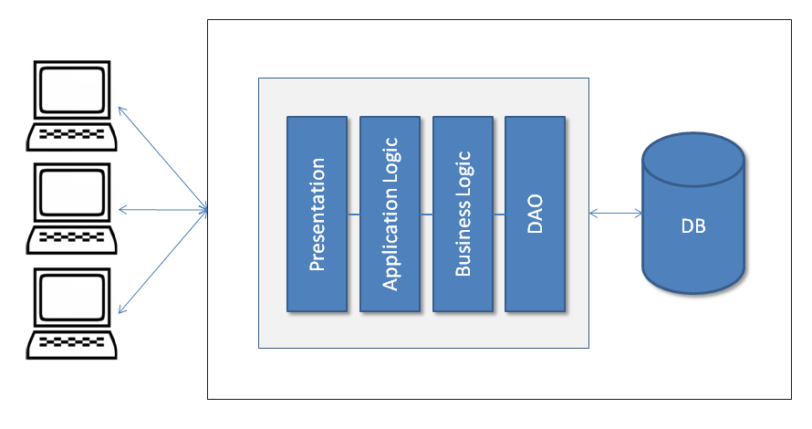
Monolithic Architecture Example

Slide 21
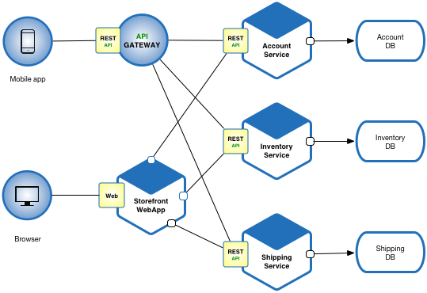
Example Microservices Architecture

Slide 22
Lab
Notes:
Lab00 – Initial setup

Slide 23
Lab Discussion

Slide 24
Microservice Design Patterns

Slide 25
Microservice Design Patterns
Aggregator
API Gateway
Chain of Responsibility
Asynchronous Messaging
Circuit Breaker
Anti-Corruption Layer
Strangler Application
Others as well (https://microservices.io/patterns/index.html)

Slide 26
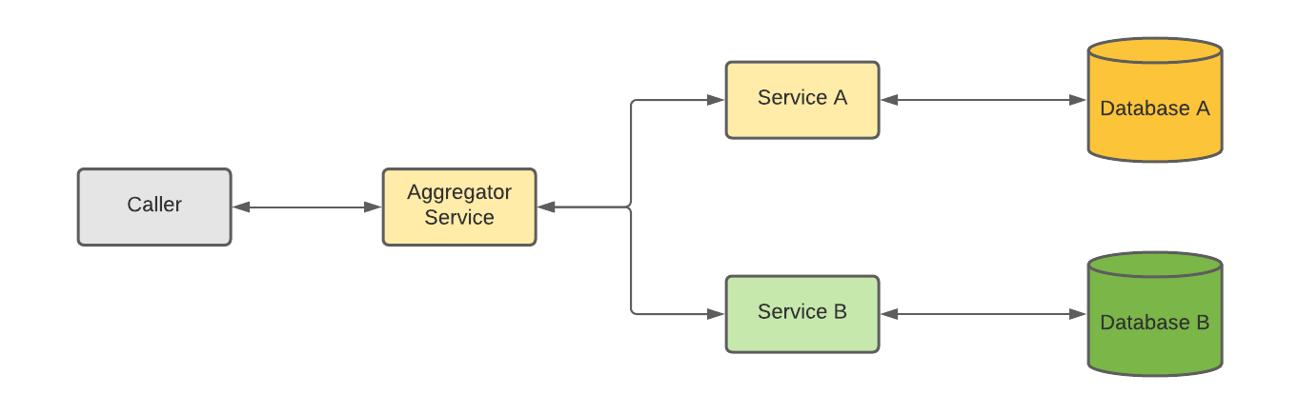
Microservice Design Patterns - Aggregator
Akin to a web page invoking multiple microservices and displaying results of all on single page
In the pattern, one microservice manages calls to others and aggregates results for return to caller
Can include update as well as retrieval ops

Slide 27
Microservice Design Patterns - Aggregator
Benefits:
Helps you practice DRY (Don’t Repeat Yourself)
Supports logic at time of aggregation for additional processing
Potential “gotchas”:
Performance if downstream microservices not called asynchronously

Slide 28
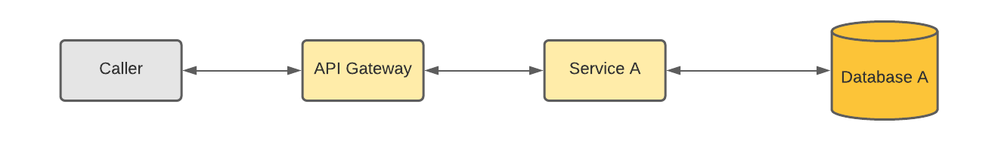
Microservice Design Patterns – API Gateway
Specific type of infrastructure that helps manage the boundary
Provides an intermediary for routing calls to a downstream microservice
Provides a protection and translation layer (if calling protocol different from microservice)
Can be combined with other patterns as well

Slide 29
Microservice Design Patterns – API Gateway
Benefits:
Usually, built in throttling (to protect against DDoS)
Can support translation between caller and downstream microservice for protocol, message format, etc.
Provides a centralized layer for AuthN/AuthZ
Can be combined with load balancing to enable scalability and resiliency
Potential “gotchas”:
Increased complexity – another component and point-of-failure
Increased response time due to additional network “hop”

Slide 30
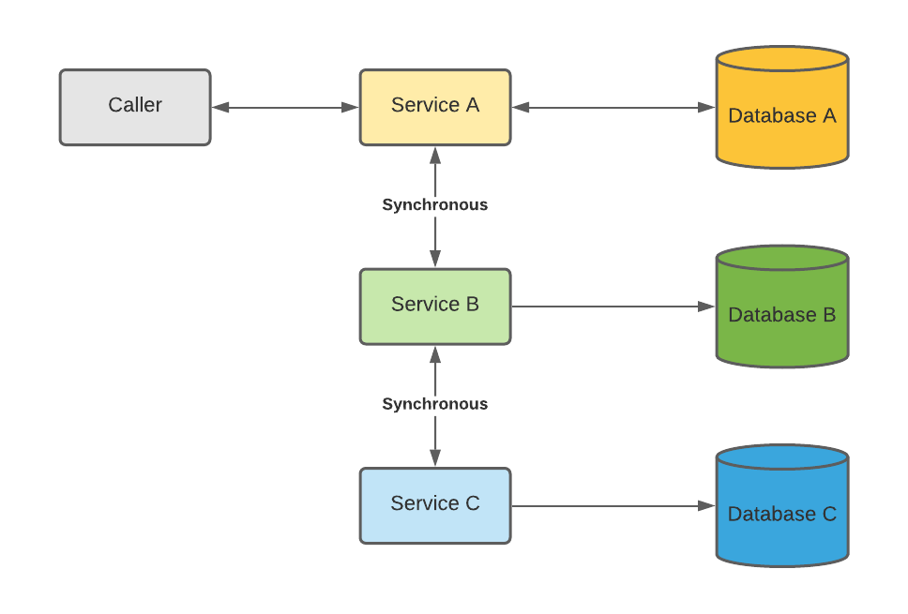
Microservice Design Patterns – Chain of Responsibility
Represents a chained set of microservice calls to complete a workflow action
Output of 1 microservice is input to the next
Uses synchronous calls for routing through chain

Slide 31
Microservice Design Patterns – Chain of Responsibility
Benefits:
Supports composition of microservices in a workflow that must happen in sequence
Synchronous communication typically less complex
Potential “gotchas”:
Increased response time – response time becomes the sum of each microservice’s response time in the chain

Slide 32
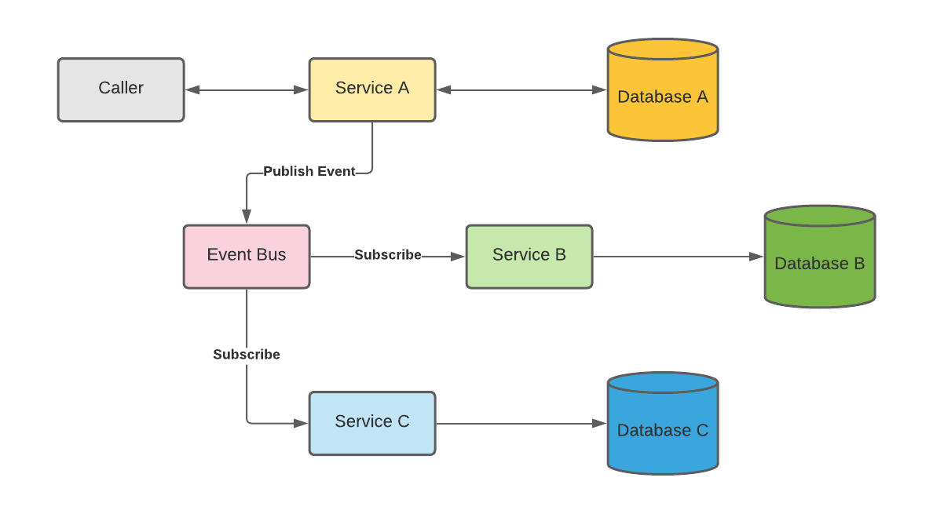
Microservice Design Patterns – Asynchronous Messaging
Supports asynchronous interaction between independent microservices
Messages published to a topic by a producer
Topic subscribed to by one or more consumers

Slide 33
Microservice Design Patterns – Asynchronous Messaging
Benefits:
Promotes looser coupling in cases where synchronous calls are not required
Allows multiple services the option of being notified (vs. point-to-point)
If given consumer is down, producer can continue to send messages and they won’t be lost (Kafka)
Potential “gotchas”:
Additional complexity
Can be harder to trace an action end-to-end (but there are ways to handle)
Not a good fit if specific timing and sequencing required

Slide 34
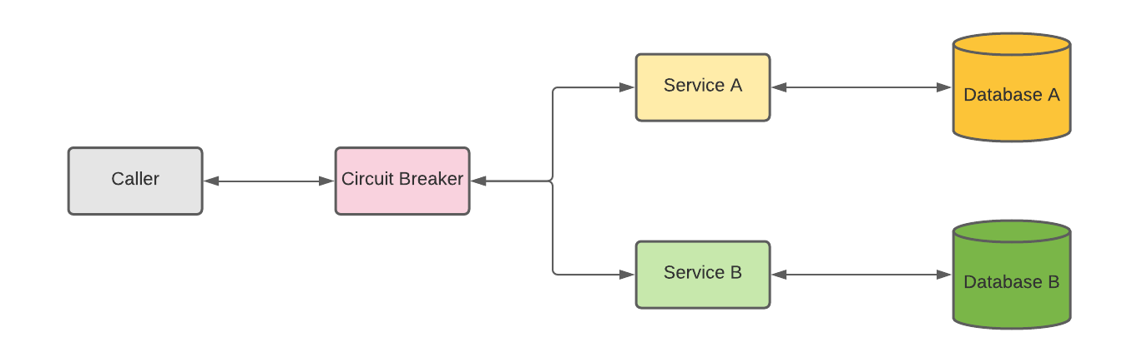
Microservice Design Patterns – Circuit Breaker
Prevents unnecessary calls to microservices if down
Circuit breaker monitors failures of downstream microservices
If number of failures crosses a threshold, circuit breaker prevents any new calls temporarily
After defined time period, sends a smaller set of requests and ramps back up if successful

Slide 35
Microservice Design Patterns – Circuit Breaker
Benefits:
Helps to optimize network traffic by preventing calls that are going to fail
Can help prevent “noise” and network overload
Potential “gotchas”:
Process supported needs to be able to absorb limited downtime
If not managed correctly, can result in poor user experience

Slide 36
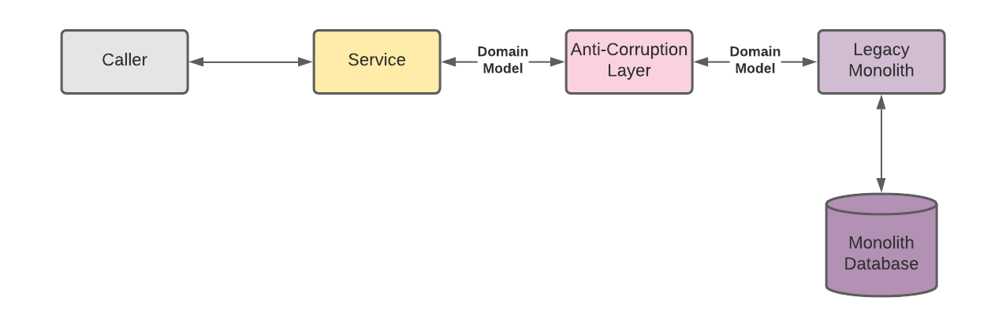
Microservice Design Patterns – Anti-Corruption Layer
Prevents corruption of new microservice domain model(s) with legacy monolith domain model(s)
Provides a proxy/translation layer to help keep models “clean”

Slide 37
Microservice Design Patterns – Anti-Corruption Layer
Benefits:
Prevents crossing of boundaries and “leaking” of sub-optimal logic
Helps to keep this insulation transparent between communicating parties
Potential “gotchas”:
Additional complexity
Additional testing required to validate the additional complexity

Slide 38
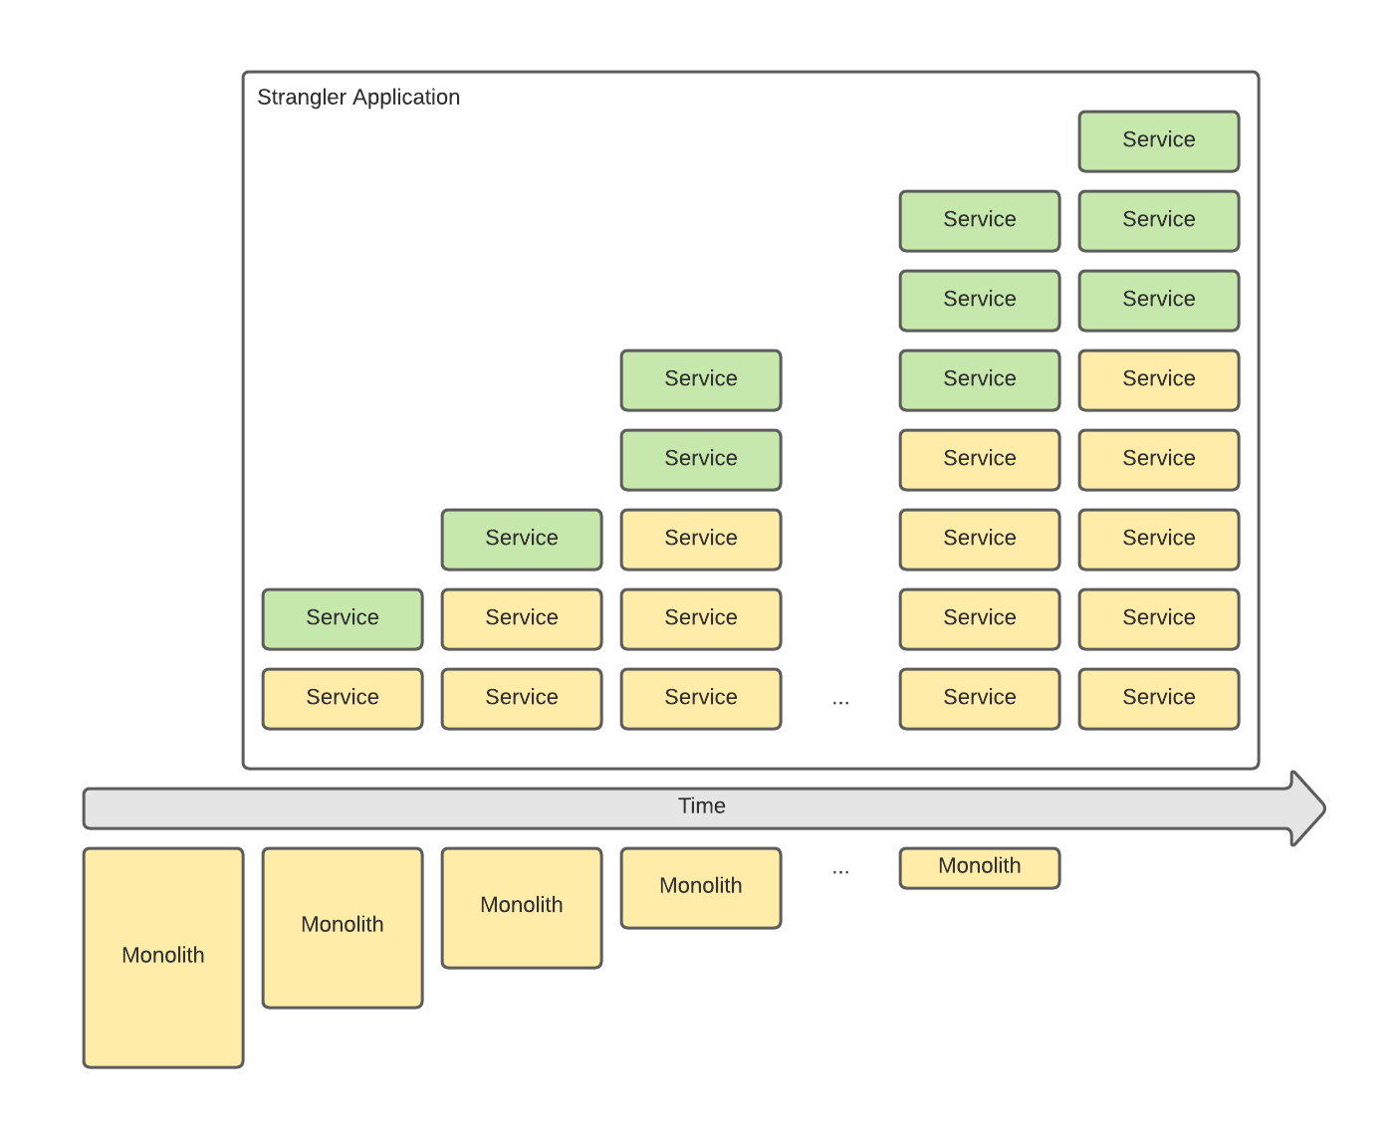
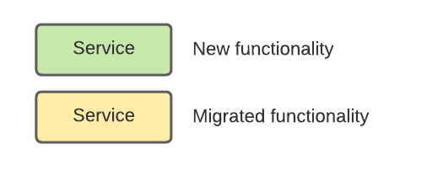
Microservice Design Patterns – Strangler Application
Supports breaking up a monolith into microservices over time
Can accommodate existing as well as new functionality

Slide 39
Microservice Design Patterns – Strangler Application
Benefits:
Allows a gradual vs. “big bang” breakup
Especially well-suited for large monoliths that are taking active traffic
Potential “gotchas”:
Requires business to be able to absorb gradual
Adds complexity – coordinating new functionality, migrated functionality, and proper integration between them
While transition in progress, will have to maintain two paths

Slide 40
Lab
Notes:
Lab01 – as you build out the set of services, think about integration patterns that might be applicable to your build

Slide 41
Event-Driven Architectures

Slide 42
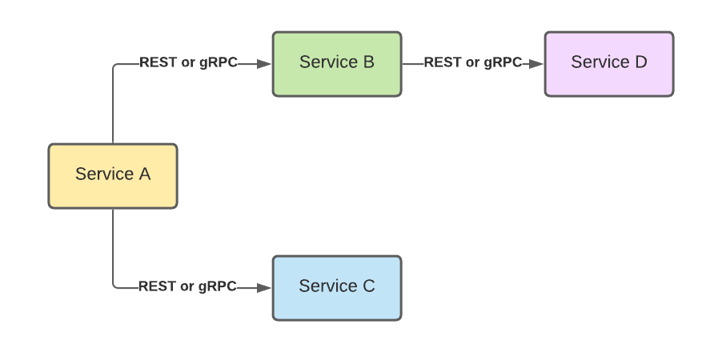
Microservices Integration Architecture – Option 1
What are some benefits of an architecture like this? What are some challenges?
Notes:
Could be containerized services, lambdas, services deployed to Elastic Beanstalk. Calls could be synchronous or asynchronous – key is direct point-to-point integration between services

Slide 43
Microservices Integration Architecture – Option 1
Benefits:
Easier to trace a workflow end-to-end
Of available options, usually less complex (relatively speaking)
Supports some level of sequential timing through a workflow
Potential “gotchas”:
Can promote point-to-point coupling
If one of the target services is down, the workflow is down
Notes:
Can use circuit breaker as discussed before, retries, etc.

Slide 44
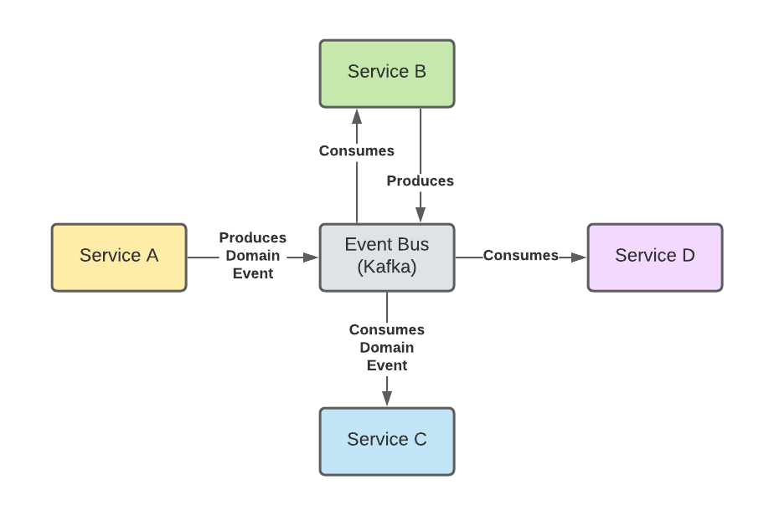
Microservices Integration Architecture – Option 2
What are some benefits of an architecture like this? What are some challenges?
Notes:
Uses concept of topics – a service can produce an event to a topic and one (or more) services can consume the event from that topic (subscriber)

Slide 45
Microservices Integration Architecture – Option 2
Benefits:
Looser coupling between services
Flexibility in how a workflow gets processed
If a consuming service is down, the event bus will hold on to the events
When consumer recovers, can pick up where they left off
Potential “gotchas”:
Observability/traceability through a workflow can be harder
Adds complexity to the technical landscape
Workload needs to be able to tolerate latency
Notes:
Eventual consistency

Slide 46
Concurrency in Go
See https://github.com/KernelGamut32/golang-live

Slide 47
Concurrency Patterns in Go

Slide 48
Concurrency Patterns in Go
Lexical confinement
Use lexical scope to manage access to data and concurrency primitives
Limit how multiple concurrent processes can interact with the data
Helps ensure correct approach to concurrency (but likely limited to simplest use cases)
For example, using directionality on channels to only expose read or write access in a controlled manner

Slide 49
Concurrency Patterns in Go
Preventing goroutine leaks
Go is very efficient at multiplexing goroutines onto available threads
As a result, goroutines are cheap and easy to create
However, do cost resources and they are not garbage collected by runtime
Common to use a “done” channel to signify termination and defer close for channels created in goroutines

Slide 50
Concurrency Patterns in Go
Error handling
If errors encountered in concurrent process, can send info as part of a struct
Rather than goroutine trying to print or handle error with limited context…
Can pass error to parts of the code that are in better position to interrogate and manage/handle

Slide 51
Concurrency Patterns in Go
Pipelines
Using concurrency primitives, data can be passed (using channels) through a series of “phases”
At each “phase”, transformation logic or processing can be applied
Output from the current “phase” gets piped into the next phase for additional processing
Enables engineers to build a series of processing that combines sets of utility steps in different ways based on requirements

Slide 52
Demo

Slide 53
Lab
Notes:
Lab02

Slide 54
Serverless Architectures

Slide 55
Serverless / Functions-as-a-Service (FaaS)
Represents a type of managed service provided by the CSP
Cost structure is usually consumption-based (i.e., you only pay for what you use)
Supports many different coding paradigms (C#/.NET, NodeJS, Python, Go ☺, etc.)
Typically, with Serverless (and PaaS), the consumer is only concerned with the application code and data – elements of the CSP’s “backbone” used to support are managed by the CSP
Includes more sophisticated automated scaling capabilities – built for Internet scale

Slide 56
AWS Lambda Using Go
Lambdas can be created in the AWS Management Console
Allows language selection and testing or can use a blueprint as a starting point
The in-browser IDE does not support Go which prevents editing in the Management Console

Slide 57
AWS Lambda Using Go
But we’re able to zip it up, push it to an S3 bucket, and then deploy from there
Likely a better development experience than the MC anyway
In addition to the Lambda, you’ll want an API Gateway in place as well

Slide 58
AWS Lambda Using Go
This Gateway will provide an HTTP REST interface to the Lambda’s operations
The Gateway will be setup as a trigger (it’s one of Lambda’s standard triggers)
The Gateway includes internal components that can proxy to/from the Lambda

Slide 59
AWS Lambda Using Go
Go packages have been provided by AWS for coding the Lambda’s handler
Provide several utility functions for managing function execution and results processing

Slide 60
Review Lambdas in AWS
Notes:
Create a simple Python lambda

Slide 61
Lab
Notes:
Lab03

Slide 62
Infrastructure-as-Code (IaC) Using Terraform

Slide 63
Terraform
While microservice components can be created manually in the AWS MC, it’s not ideal
IaC (Infrastructure-as-Code) is a better alternative
Infrastructure code (like all other code) is code
Can be tested, versioned, put in source control, etc.
Multiple options available for tooling to support

Slide 64
What is Terraform?
A form of “infrastructure as code”
Declarative domain-specific language
What is declarative?
Used to describe idempotent resource configurations, typically in cloud infrastructure
According to Hashicorp:
Terraform enables you to safely and predictably create, change, and improve infrastructure. It is an open-source tool that codifies APIs into declarative configuration files that can be shared amongst team members, treated as code, edited, reviewed, and versioned

Slide 65
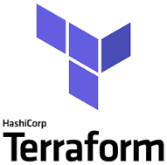
What is Terraform? (cont’d)
Open source CLI tool for infrastructure automation
Utilizes plugin architecture
Extensible to any environment, tool, or framework and works primarily by making API calls to those environments, tools, or frameworks
Detects implicit dependencies between resources and automatically creates a dependency graph
Builds in dependency order and automatically performs activities in parallel where possible
...Sequentially for dependent resources

Slide 66
Why Use Terraform?
Readable
Repeatable
Certainty (i.e., no confusion about what will happen)
Standardized environments
Provision quickly
Disaster recovery

Slide 67
What Does Terraform (HCL) Look Like?
resource “aws_instance” “web” {
ami = “ami-19827362728”
instance_type = “t2.micro”
tags = {
Name = “my-first-instance”
}
}

Slide 68
Hashicorp Configuration Language (HCL)
The goal of HCL is to build a structured configuration language that is both human and machine friendly for use with command-line tools, but specifically targeted towards DevOps tools, servers, etc.
Fully JSON compatible
Made up of stanzas or blocks, which roughly equate to JSON objects. Each stanza/block maps to an object type as defined by Terraform providers (we’ll talk more about providers later)
https://github.com/hashicorp/hcl

Slide 69
Terraform Project Content Types
*.tf, *.tf.json
HCL or JSON
these files define your declarative infrastructure and resources
*.tfstate
JSON files that store state, reference to resources
created and maintained by terraform
terraform.tfvars, terraform.tfvars.json and/or *.auto.tfvars, *.auto.tfvars.json
HCL or JSON
variable definitions in bulk
(more to come on setting variable values at runtime)

Slide 70
Resources
*.tf files contain your HCL declarative definitions
resource “aws_instance” “web” {
ami = “ami-19827362728”
instance_type = “t2.micro”
tags {
Name = “my-first-instance”
}
}
Most blocks in your HCL represent a resource to be created/maintained by Terraform

Slide 71
Resources
Resources are key elements and captured as top-level objects (stanzas) in Terraform configuration files
Each resource stanza indicates the intent to idempotently create that resource
Body of resource contains configuration of attributes of that resource
Each provider (e.g., AWS, Azure, etc.) provides its own set of resources and defines the configuration attributes
When a resource is created by Terraform, it’s tracked in Terraform state
Resources can refer to attributes of other resources, creating implicit dependencies
Dependencies trigger sequential creation

Slide 72
Terraform Commands and the CLI
The CLI is how you’ll most often use terraform
terraform init …
terraform plan …
terraform apply …
And plenty more: terraform --help or https://www.terraform.io/docs/commands/index.html
Third-party SDKs also available for running and interacting with Terraform (e.g., scalr, terragrunt, terratest)

Slide 73
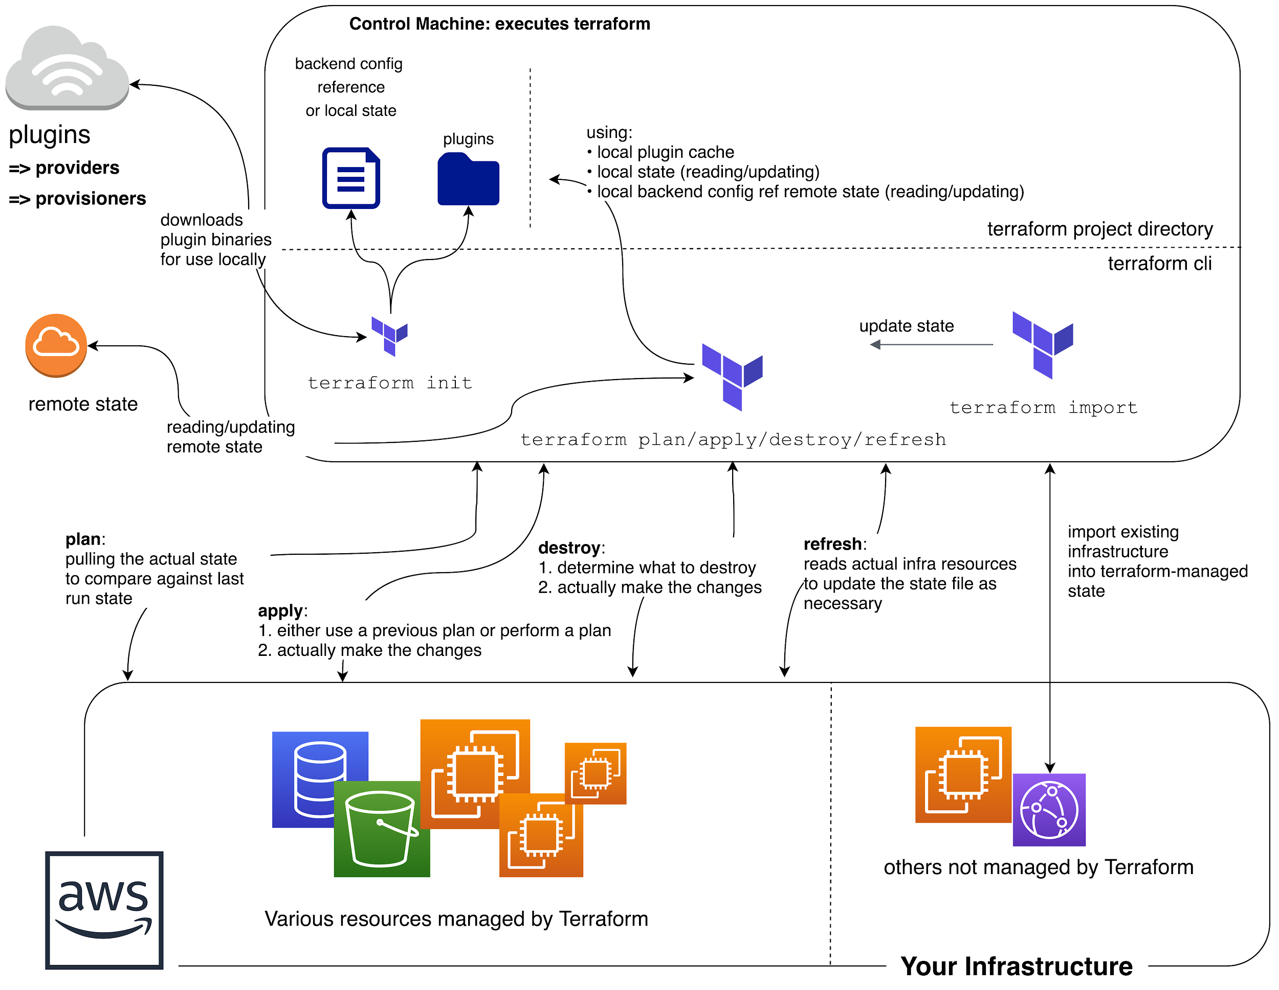
Big picture look at
Terraform Command Flow

Slide 74
terraform init
A special command, run before other commands/operations
What does it do?
Downloads required provider packages
Downloads modules referenced in the HCL (more on modules later)
Initializes state
Local state: ensuring local state file(s) exist
Remote state: more complex initialization (more on remote state later)
Basic syntax check
Idempotent
Uses a .terraform directory?
init downloads the provider packages and modules to this directory
Also, where state files live (locally)

Slide 75
Input Variables
Enable interchangeable values to be stored centrally and referenced single or multiple times
Similar to variables in other languages
Declared in variable stanzas
Parsed first
Cannot interpolate or reference other variables
Allow for default values
Optionally specify value type, e.g.,
List, Map, String

Slide 76
Input Variables
Input variable definitions support the following
default – provides default value if not specified; makes optional
type – type of value accepted for the variable
description – string description/documentation
validation – block for defining validation rules for input
sensitive – true or false; limits output as part of TF operations (plan or apply)

Slide 77
Example Variable Definition
variable “instance_size” {
default = “t2.micro”
type = string # changed in 0.12
description = “Size of EC2 instance”
}

Slide 78
Example Variable Definition
variable “student_alias” {
type = string
description = “Your student alias”
validation {
condition = trimprefix(var.student_alias, “test”) == var.student_alias
error_message = “Please do not use test aliases with this deployment.”
}
}

Slide 79
Data Sources
Logical references to data objects stored externally to the tfstate file
Allows you to reference resources not created by Terraform
Examples
current default region in AWS CLI
AMI ID search
AWS ARN lookup
AWS VPC CIDR range
Notes:
AMI = Amazon Machine Image
ARN = Amazon Resource Name
CIDR = Classless Internet Domain Routing

Slide 80
Data Source Example: AWS AMI Lookup
data "aws_ami" "latest-ubuntu" {
most_recent = true
owners = ["099720109477"]
filter {
name = "name"
values = ["ubuntu/images/hvm-ssd/ubuntu-xenial-16.04-amd64-server-*"]
}
filter {
name = "virtualization-type"
values = ["hvm"]
}
}
Notes:
HVM = hardware virtual machine (cf. xen)

Slide 81
Providing Values for Input Variables
Multiple options
Using environment variables (prefixed with “TF_VAR_”)
Defining inputs in a terraform.tfvars file
Defining inputs in a terraform.tfvars.json file
Defining inputs in one or more *.auto.tfvars files
Defining inputs in one or more *.auto.tfvars.json files
-var and -var-file options on the command-line

Slide 82
Providing Values for Input Variables
Environment Variables
Order Loaded
Precedence
terraform.tfvars File (if present)
Processed in lexical order of filenames
terraform.tfvars.json File (if present)
*.auto.tfvars File(s) (if present)
*.auto.tfvars.json File(s) (if present)
-var and -var-file Cmd Line Options
Processed in order provided on cmd

Slide 83
Providing Values for Input Variables
Primarily used when executing Terraform via CLI
Not really used with Terraform Enterprise
Can “push” those variables + values to Enterprise (in files)
But manage from “Variables” section of the environment

Slide 84
State
Stores information about resources that are created by Terraform
Also includes values computed by the provider APIs
Local file
.tfstate
Or backends are also available…

Slide 85
Backends
Determines how state is loaded and how operations like apply are executed
Enables non-local file state storage, remote execution, etc.
Why use a backend?
Can store their state remotely and protect it to prevent corruption
Some backends, e.g., Terraform Cloud automatically store all revisions
Keep sensitive information off local disk
Remote operations
Apply can take a LONG time for large infrastructures
Notes:
Swift = objecy/blob store

Slide 86
Backends (cont’d)
Examples
S3
swift
http
Terraform Enterprise
etc.
Notes:
Swift = objecy/blob store

Slide 87
Providers
Responsible for understanding API interactions and exposing resources
Hashicorp helps companies create providers to be added to ecosystem
Declared in HCL config files as a provider stanza
Each Terraform project can have multiple providers, even of the same type
Describes resources, their inputs, outputs, and the logic to create and change them
Many options
AWS, GCP, Azure, and many many others
providers available for non-infra services as well such as gmail, MySQL, and Pagerduty

Slide 88
The AWS Provider
Provider documentation
https://www.terraform.io/docs/providers/aws/index.html
HUGE amount of resources
Something like 8 resources per service on average

Slide 89
Configuring the Provider
provider “aws” {
region = “us-west-1”
access_key = “[your access key]”
secret_key = “[your secret access key]”
}

Slide 90
Output Variables
inputs to a Terraform config are declared with variables stanzas
outputs are declared with a special output stanza
Can be referenced through the modules interface or the CLI

Slide 91
Output Variables
Output variable definitions support the following
value – value to be returned as output
description – string description/documentation
sensitive – true or false; limits output as part of TF operations (plan or apply)

Slide 92
Output Definition
output “instance_public_ip” {
value = aws_instance.web.public_ip
}

Slide 93
Demo
https://github.com/ludesdeveloper/terraform-lambda-golang

Slide 94
Lab
Notes:
Lab04

Slide 95
Docker

Slide 96
Setting Up a Local Docker Dev Environment
Tools:
Docker Desktop
Code editor/IDE that plays nice with containers (e.g., VS Code)

Slide 97
The Dockerfile
Tells Docker what to do in creating an image for your application
The commands are all things you could do from the CLI
Used by the docker “build” command
Docker build uses this file and a “context” – a set of files at a specified location – to make your image

Slide 98
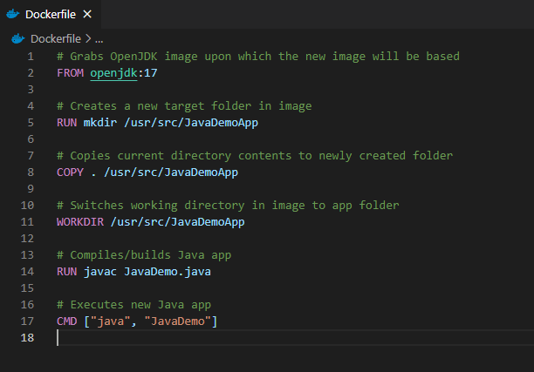
Dockerfile example
The following creates an image for building/running Java app in container
See https://github.com/KernelGamut32/dockerlab-repo-sample for sample

Slide 99
Docker Images
Represent templates defining an application environment
New instances of the application can be created from the image
These instances are called containers

Slide 100
Docker Images
Images are defined via a Dockerfile definition
Support layers for building up the environment in stages
Fully defines the application, including all components required to support

Slide 101
Docker Images
Those components can include:
Runtime
Development framework
Source code
Executable instructions for container startup

Slide 102
Docker Images
Start with a base that gives your app a place to live
Needed OS/runtimes/dB server applications, etc.
Examples:
nginx
Node
MySQL
Apache HTTP Server
IIS with .NET Runtimes

Slide 103
Docker Hub
Centralized registry for image storage & sharing
Can signup for an account – user accounts offer both free and pro versions
Also, supports organizations for grouping of multiple team members

Slide 104
Docker Hub
Accessible at https://hub.docker.com
Search feature enables search for image by technology or keyword
Image detail displays available tags and image variants

Slide 105
Docker Hub
May also include examples of usage
Pro account supports image scanning for security vulnerabilities
Can be useful for image reuse and image sharing across a dev team

Slide 106
Docker Hub
There are other registry types, including private registries

Slide 107
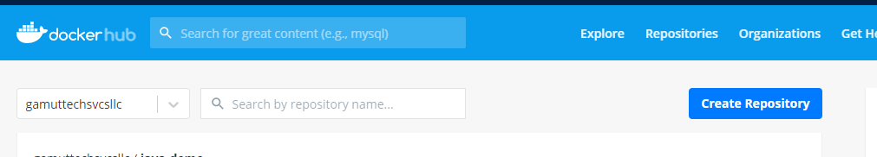
Docker Hub

Slide 108
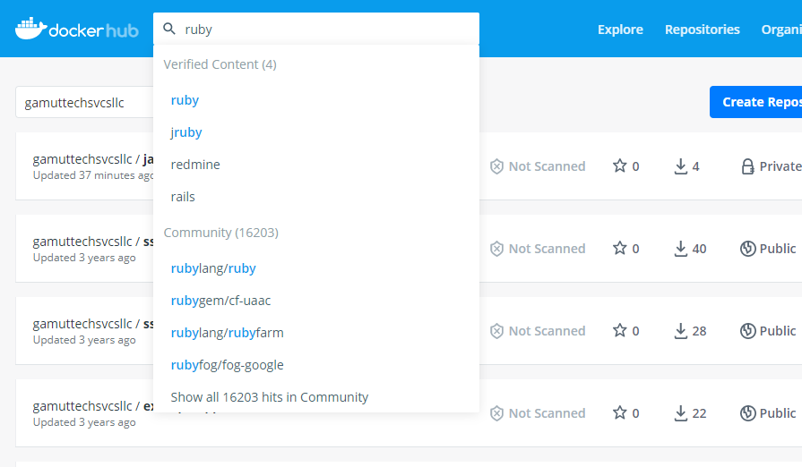
Docker Hub

Slide 109
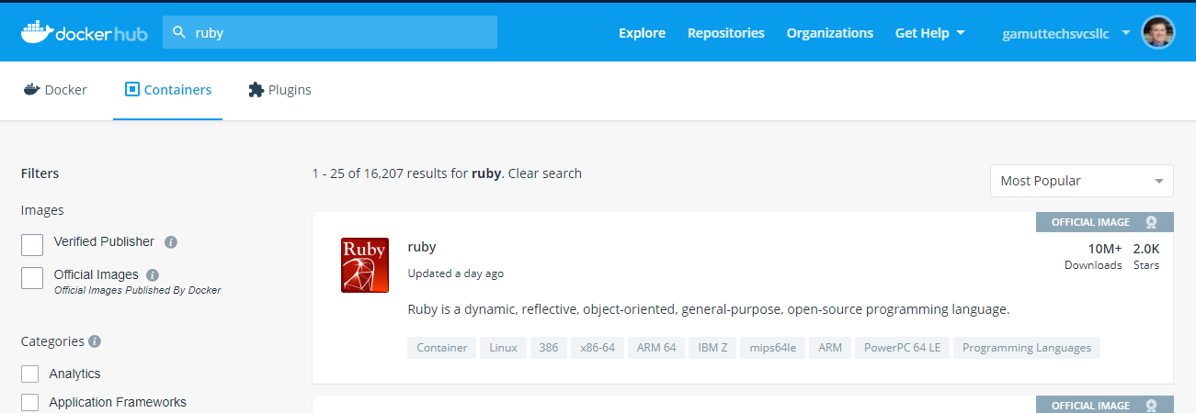
Docker Hub

Slide 110
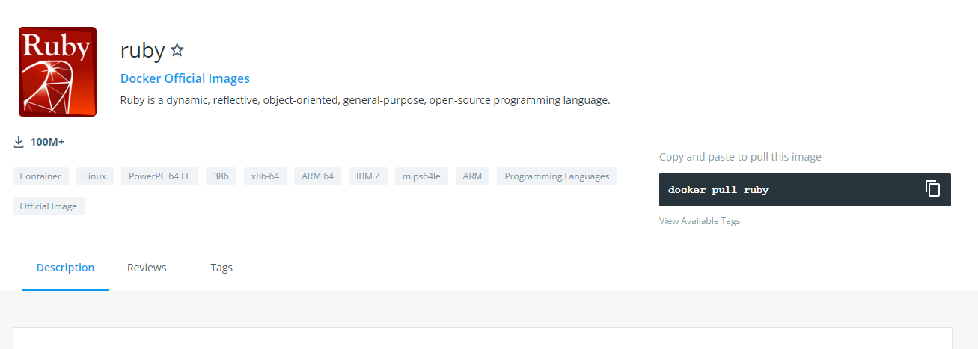
Docker Hub

Slide 111
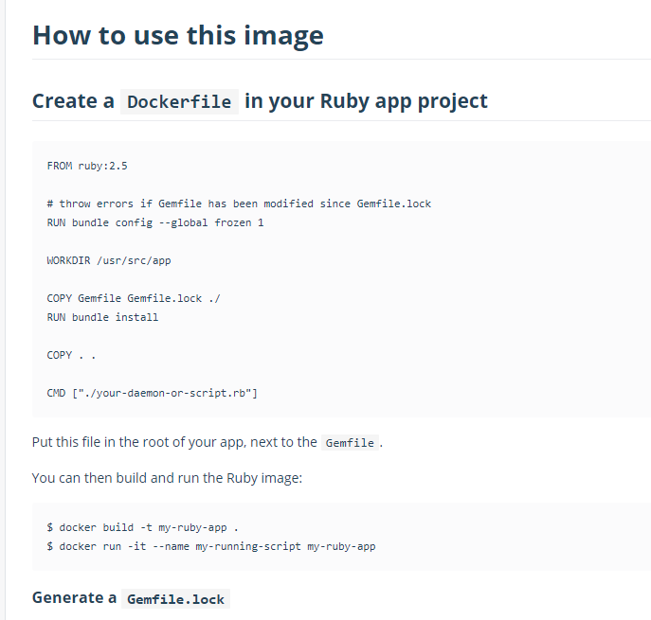
Docker Hub

Slide 112
Building The Image
To build the image from Dockerfile use docker build
docker build -t <tag name> <path to Dockerfile>
For example, docker build -t java-demo .
Builds image from Dockerfile in current folder (.) with tag name “java-demo”

Slide 113
Building The Image
For tag name, can include optional detail:
Docker ID in Docker Hub for eventual push to image registry
Version identifier for tag – defaults to “latest” if excluded
For example, docker build -t <docker ID>/<tag name>:<version> .

Slide 114
Application Bootstrapping with Docker and k8s
Kubernetes provides a hosting environment for containerized applications
Once you have a Docker image, you can work entirely within Kubernetes to deploy your app

Slide 115
Open Container Initiative (OCI)
The OCI is an open governance structure for the express purpose of creating open industry standards around container formats and runtimes
Docker started it
They have two specs: runtime-spec and image-spec
This deals with containers in the abstract

Slide 116
Competing Container Runtimes
rkt from CoreOS
Mesos from Apache
LXC Linux containers

Slide 117
Demo
Notes:
Lab04

Slide 118
Continue Lab
Notes:
Lab04

Slide 119
Kubernetes & Container Orchestration

Slide 120
Kubernetes (k8s) Overview
Kubernetes is a portable, extensible, open-source platform for managing containerized workloads and services

Slide 121
What is an Orchestrator and Why Do We Need It?
What would it look like to manually control the containers needed for your application as your app scales or containers fail?
“Orchestration” is the execution of a defined workflow
We can use an orchestrator to start and stop containers automatically based on your set rules
What does this open up for you?

Slide 122
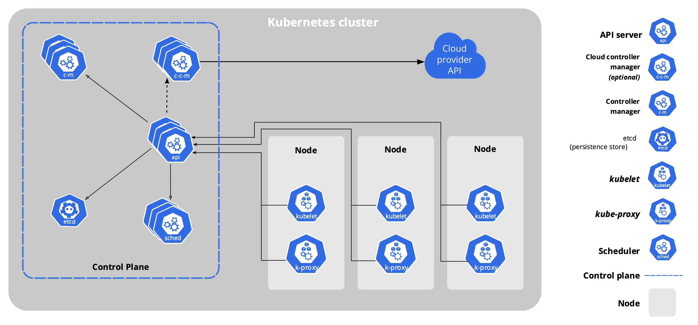
Architecture of k8s System

Slide 123
Core Components of k8s
When you deploy Kubernetes, you get a cluster.
A Kubernetes cluster consists of a set of worker machines, called nodes, that run containerized applications. Every cluster has at least one worker node.
The worker node(s) host the Pods that are the components of the application workload.
The control plane manages the worker nodes and the Pods in the cluster.

Slide 124
k8s Resource/Manifest
Kubernetes manifests are text files, usually written in YAML
They are used to create, modify and delete Kubernetes resources

Slide 125
Kubernetes Architecture
Kubernetes automates and monitors the lifecycle of a stateless application
It can scale the app up or down and ensure it keeps running
Kubernetes cluster consists of computers called nodes
The basic unit of work in kubernetes is called a pod, which is a group of one or more containers
Kubernetes can be divided into planes
Control plane - the actual pods that the kubernetes core components runs on, exposing the api, etc...
Data Plane - everything else meaning the nodes and pods which the application runs on

Slide 126
Kubernetes Architecture
In short, control plane is what monitors the cluster, schedules the work, makes the changes, etc…
The nodes are what actually do the real work, report back to the master, and watch for changes

Slide 127
Kubernetes Control Plane & Data Plane
Kubernetes is actually a collection of pods implementing the k8s api and the cluster orchestration logic (AKA the Kubernetes control plane)
The application/data plane is everything else, meaning all the nodes that host all the pods that the application runs on
The controllers of the control plane implement control loops that repeatedly compare the desired state of the cluster to its actual state
When the state of the cluster changes, controllers take action to bring it back inline with desired state

Slide 128
Declarative and Desired State
Kubernetes supports a declarative model – we can send the api a yaml file in a declarative form
Desired state means that we specify in the yaml file our desired state and the cluster takes responsibility to make sure it will happen
We describe the desired state using a yaml or json file that serves as a record of intent, but we do not specify how to get there (this is kubernetes responsibility to get us there)
Things could change or go wrong over the lifetime of the cluster (node failing, etc…), Kubernetes is responsible to always make sure that the desired state is kept intact
Kubernetes control plane controllers are always running in a loop and checking that the actual state of the cluster matches the desired state, so that if any error occurs they kick in and rectify the cluster

Slide 129
Reconciling state
Watch for the spec fields in the YAML files
The spec describes what we want the thing to be
Kubernetes will reconcile the current state with the spec (technically, this is done by a number of controllers)
When we want to change a resource, we update the spec, and reapply
Kubernetes will then converge that resource

Slide 130
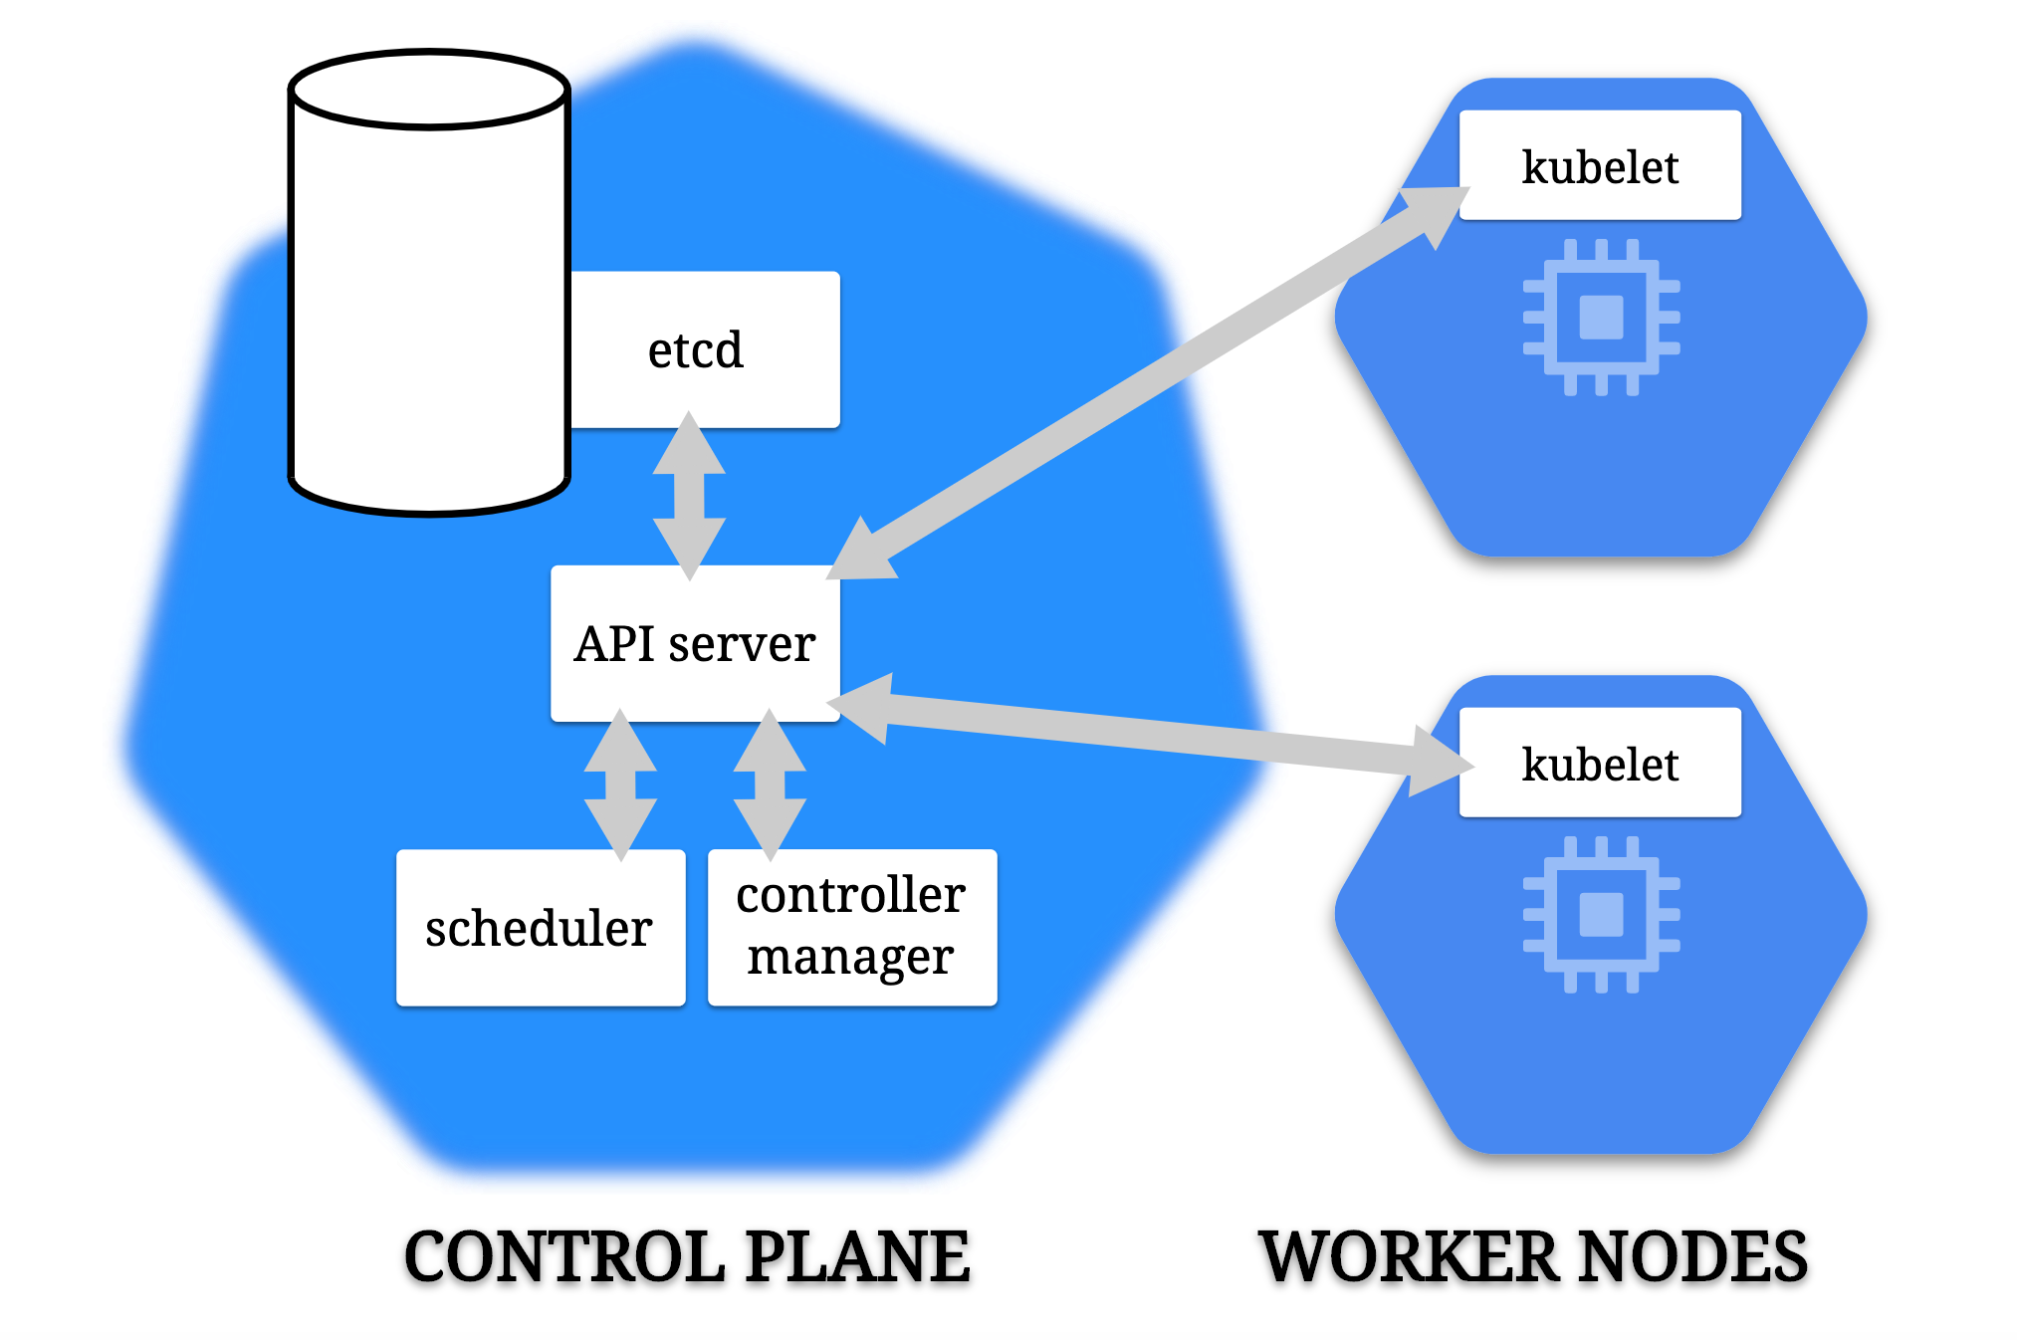

Slide 131
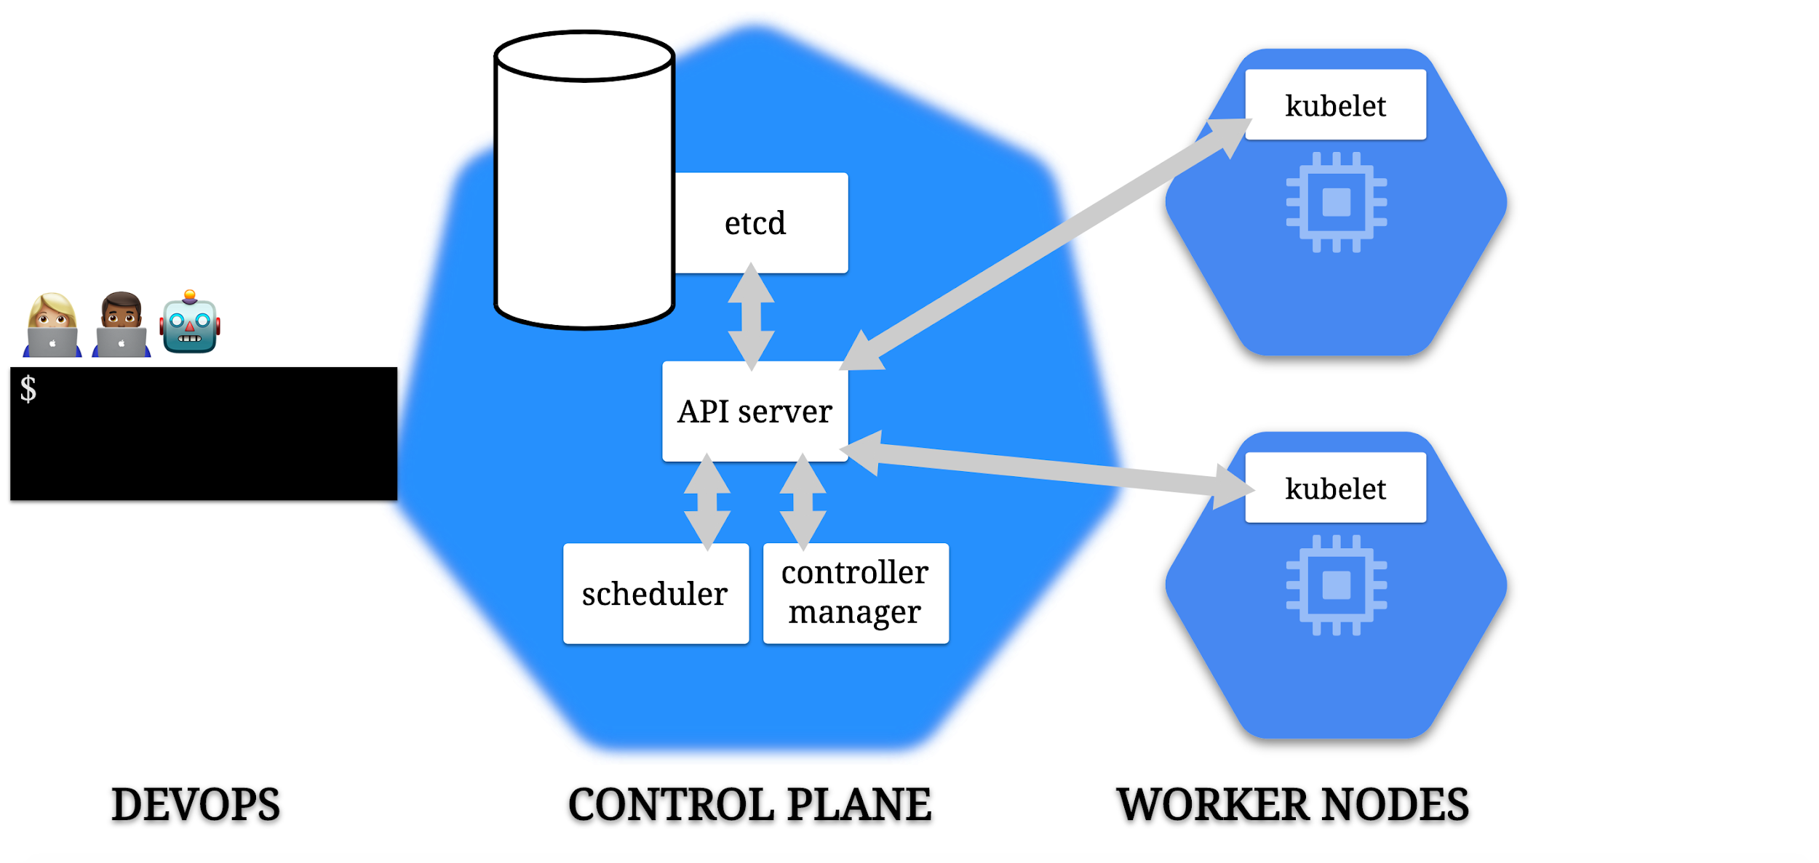

Slide 132
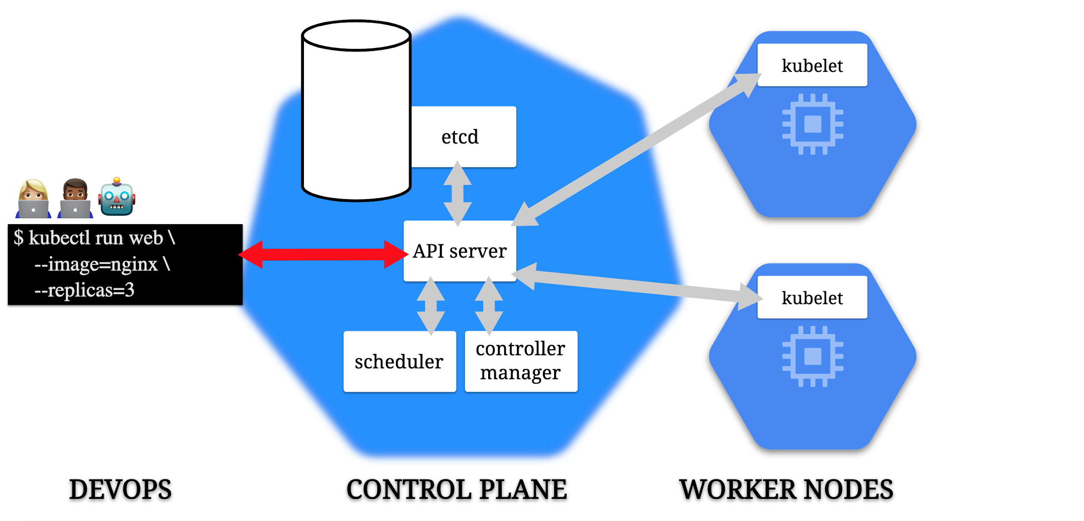

Slide 133
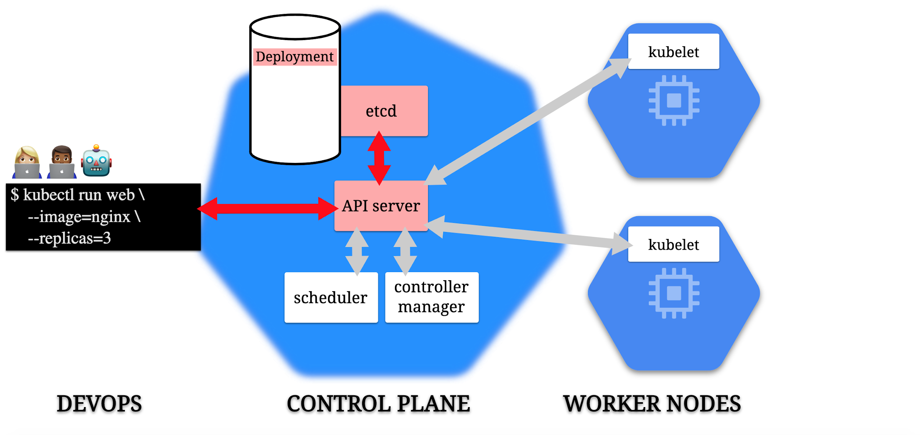

Slide 134
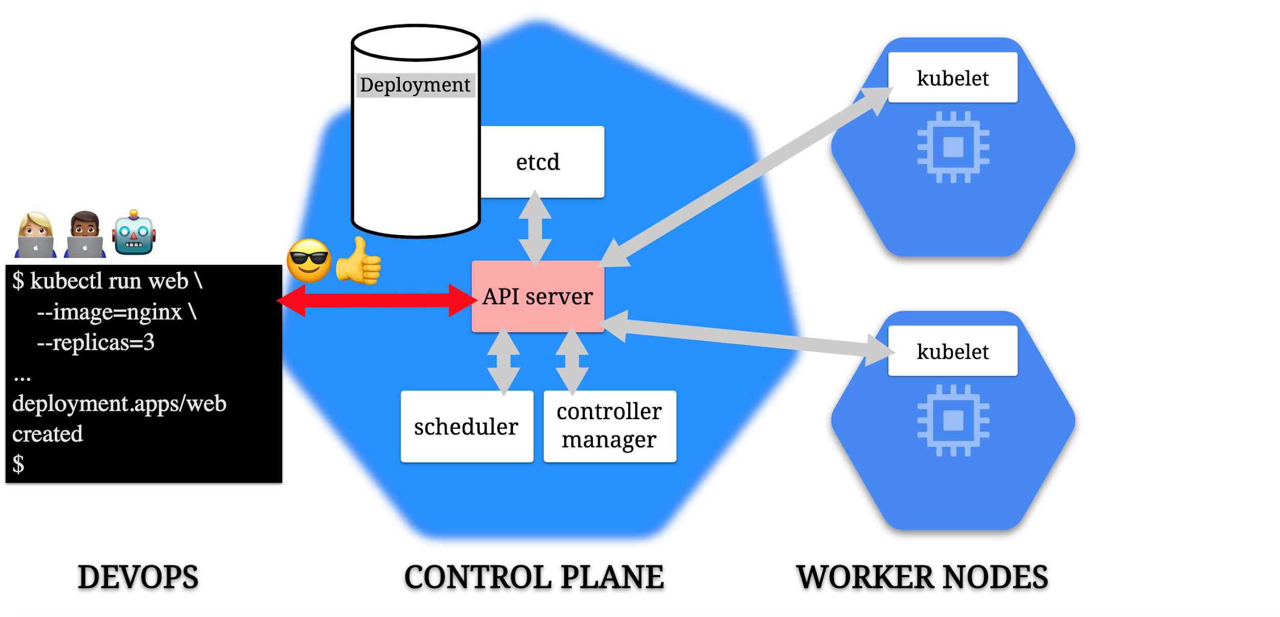

Slide 135
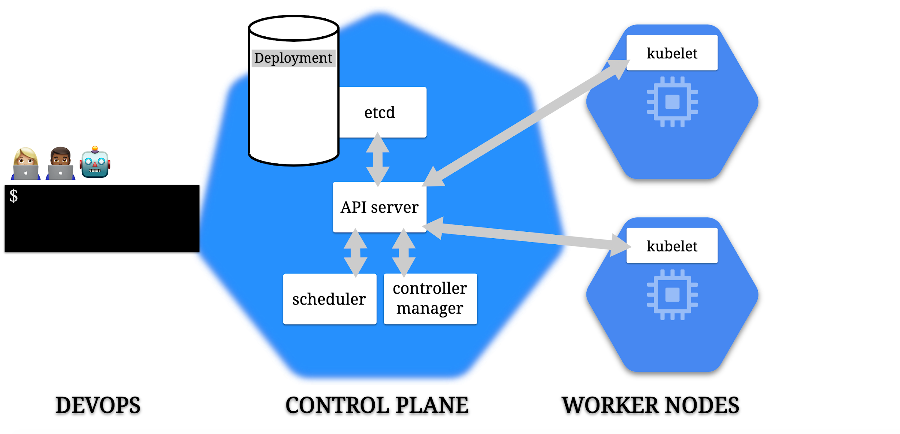

Slide 136
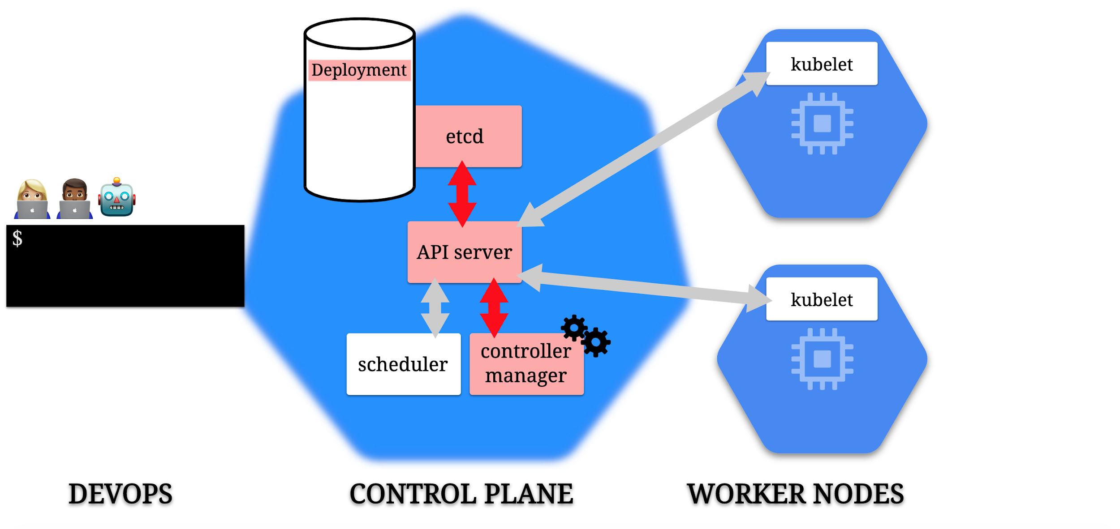

Slide 137
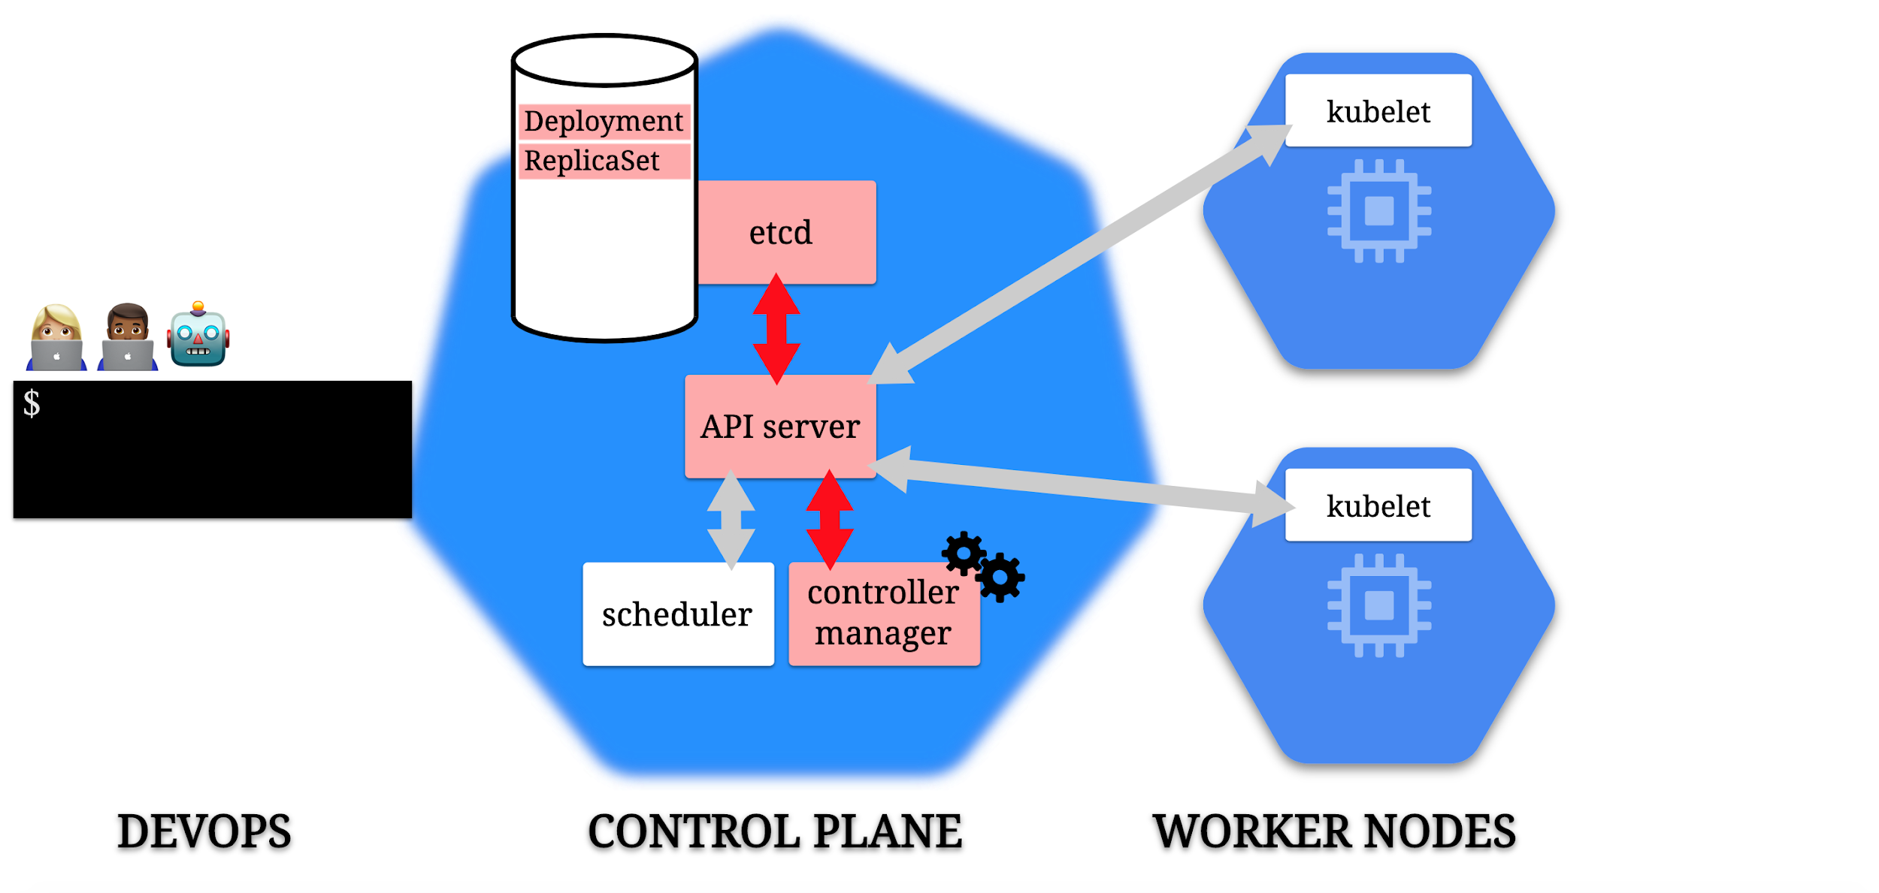

Slide 138
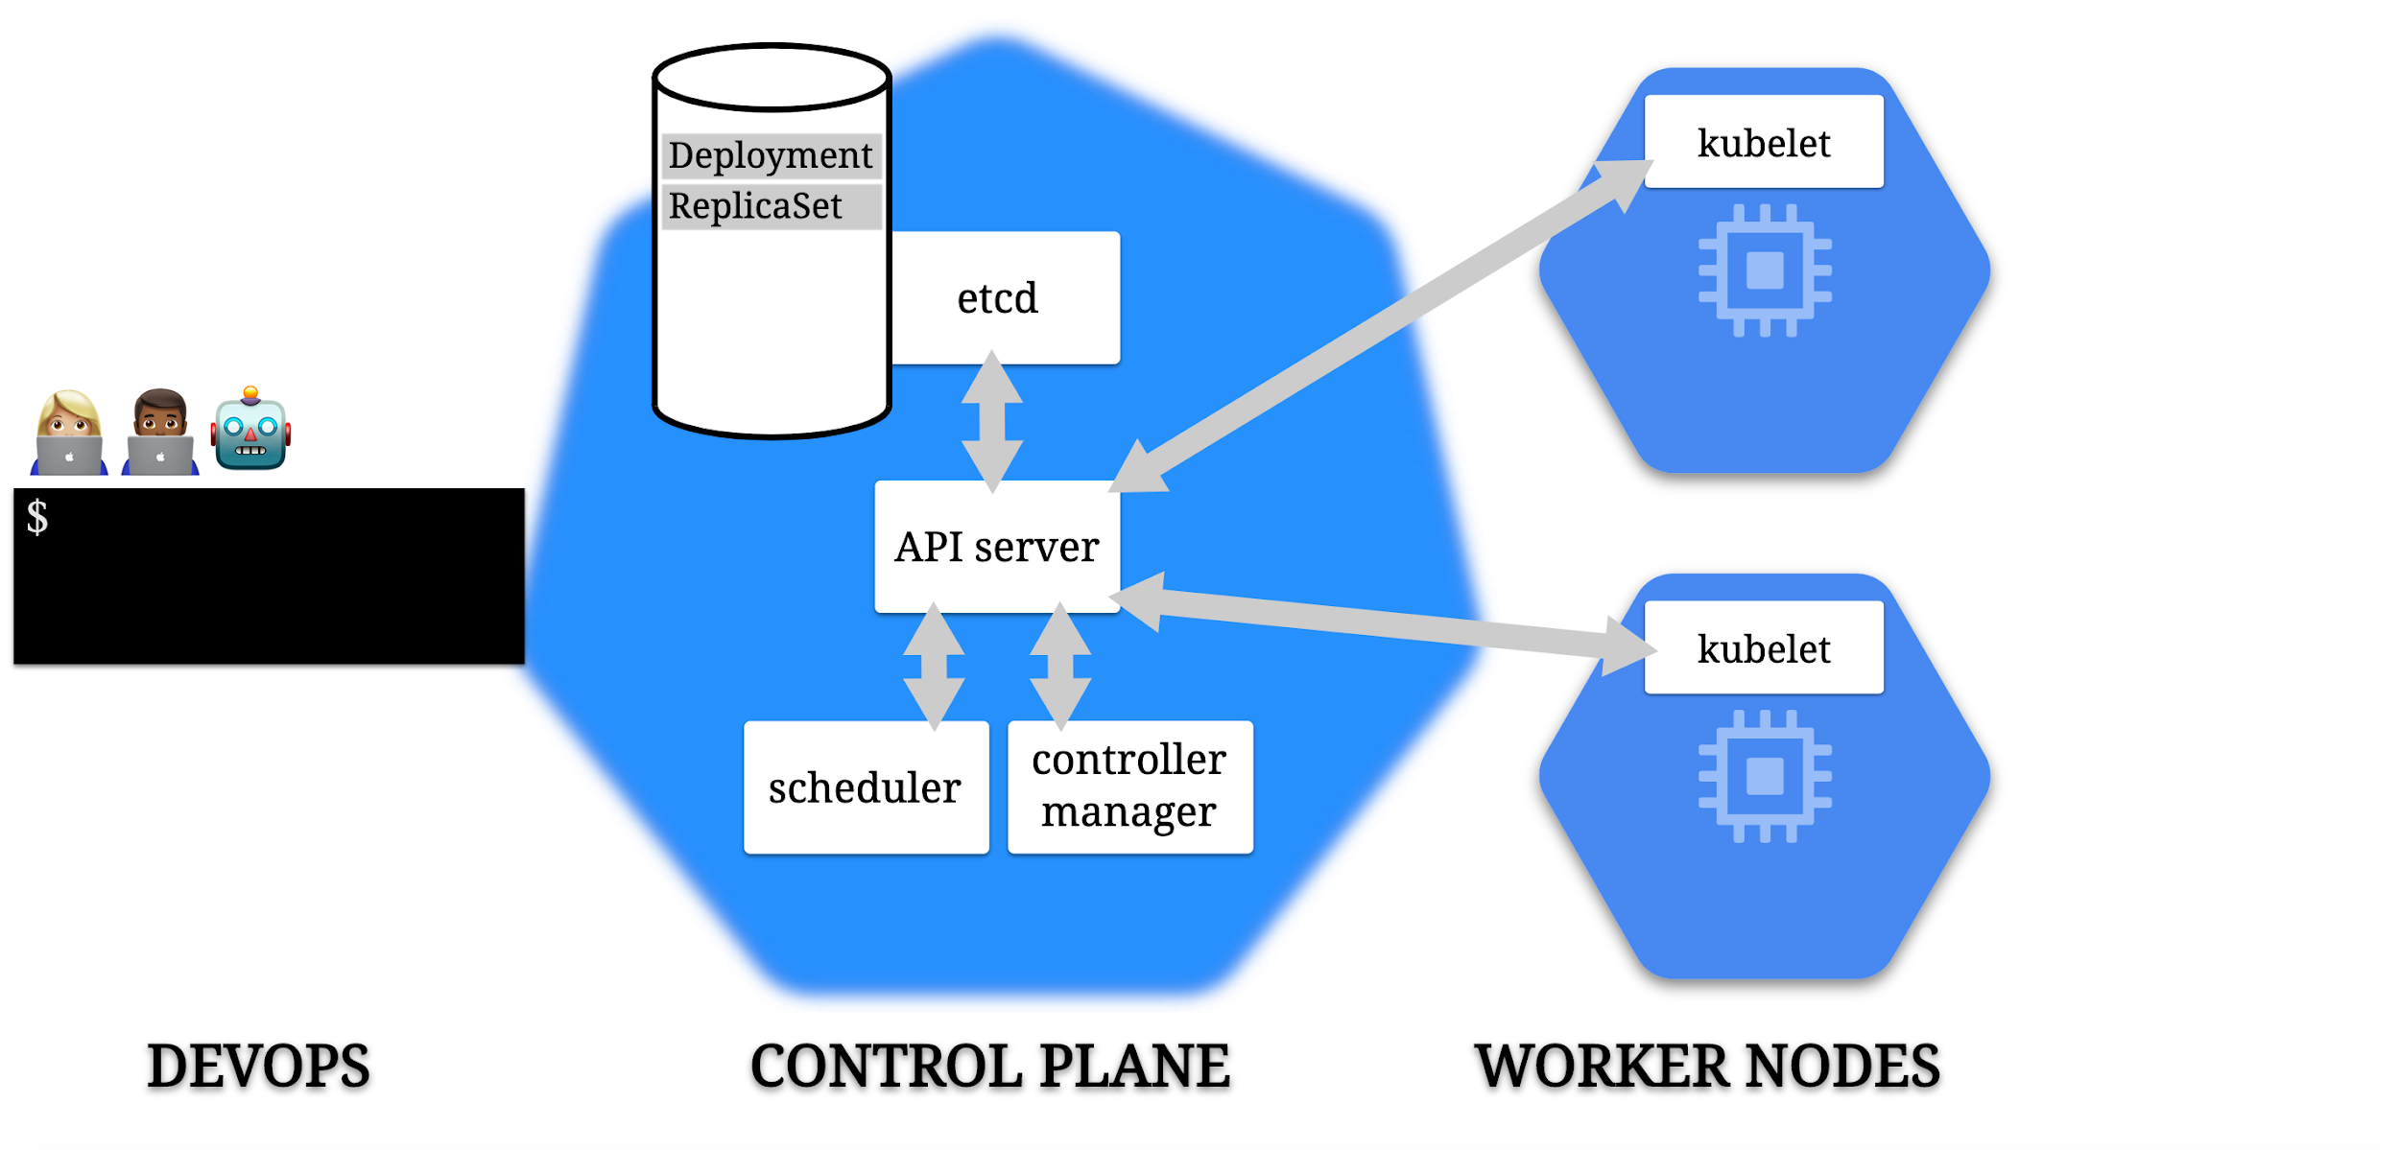

Slide 139
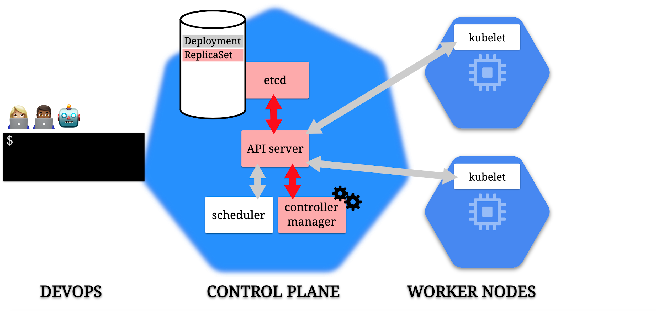

Slide 140
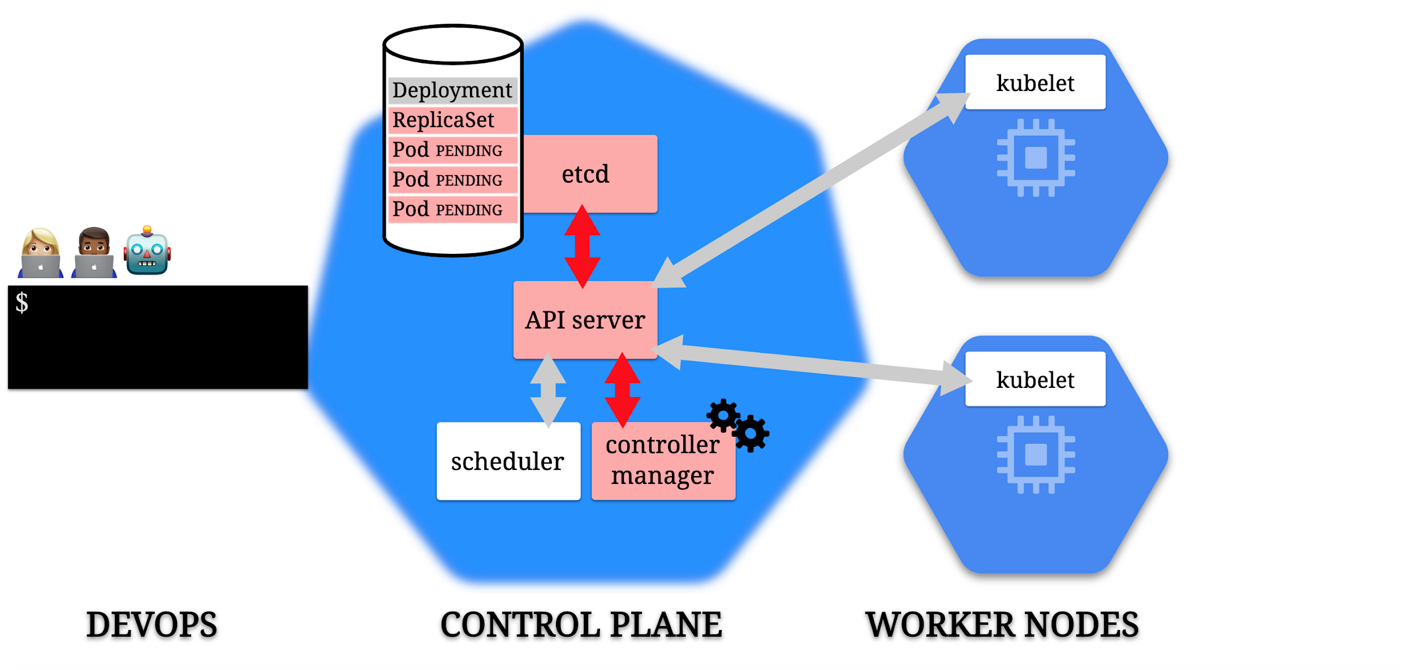

Slide 141
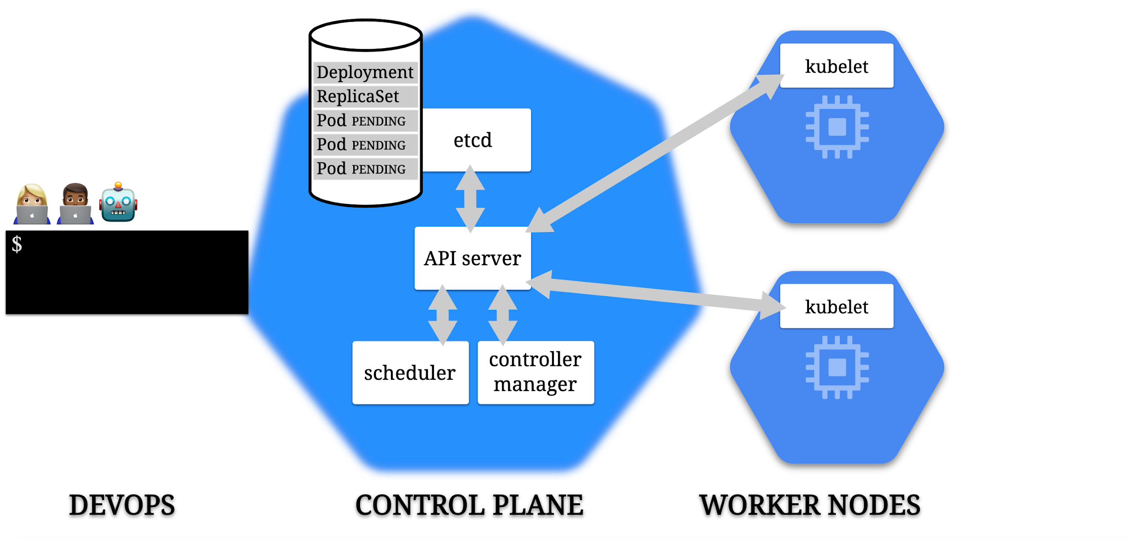

Slide 142
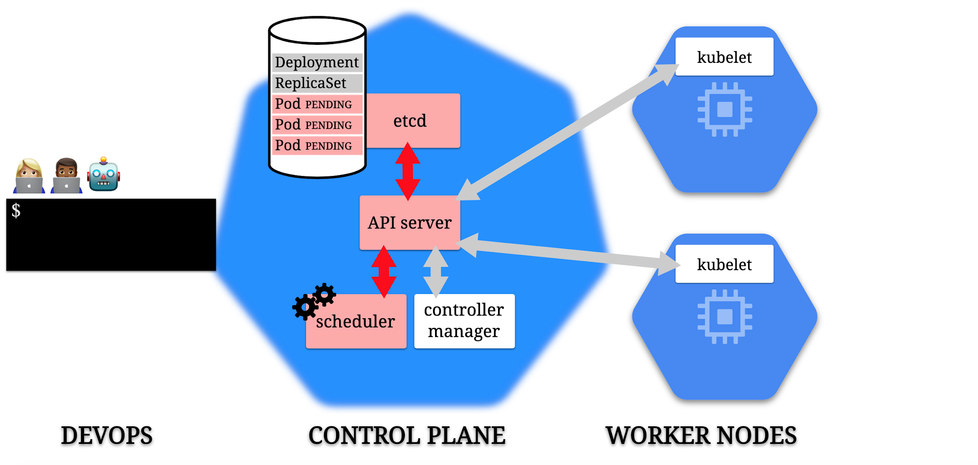

Slide 143
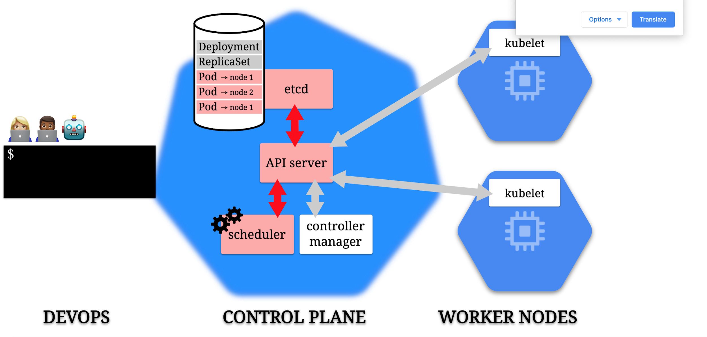

Slide 144
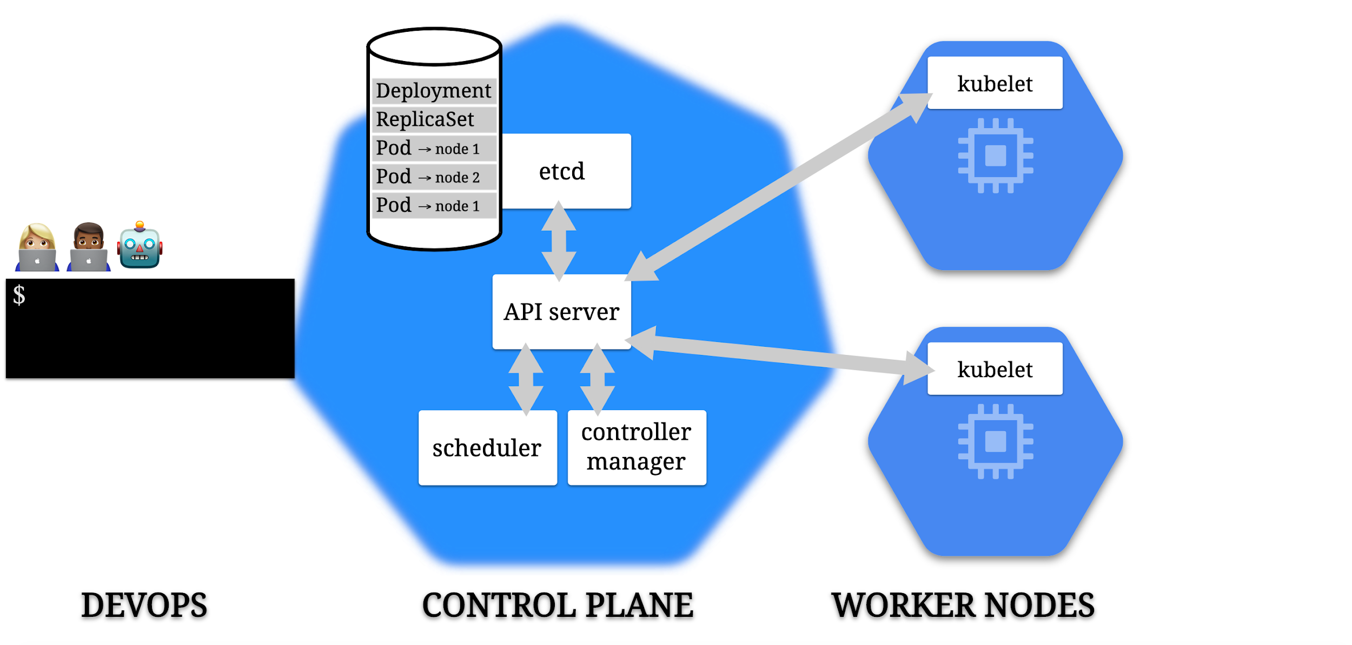

Slide 145
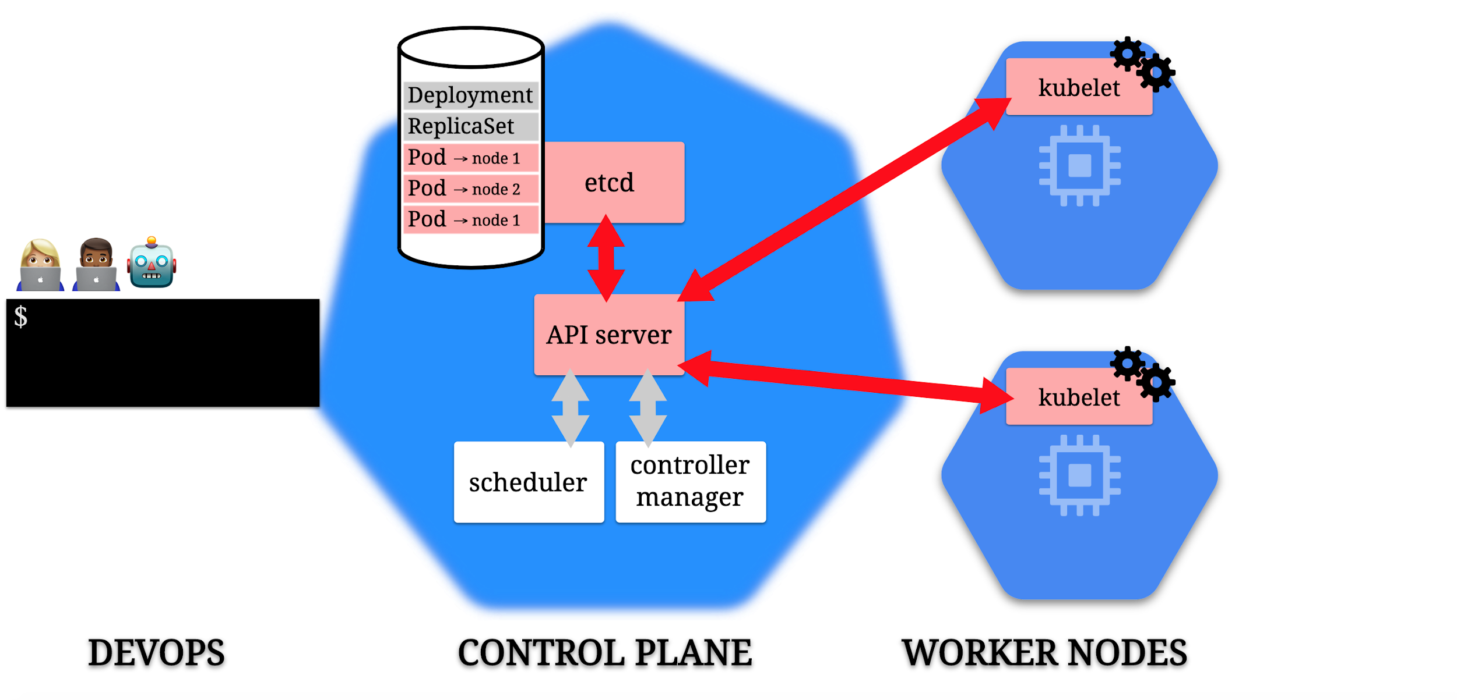

Slide 146
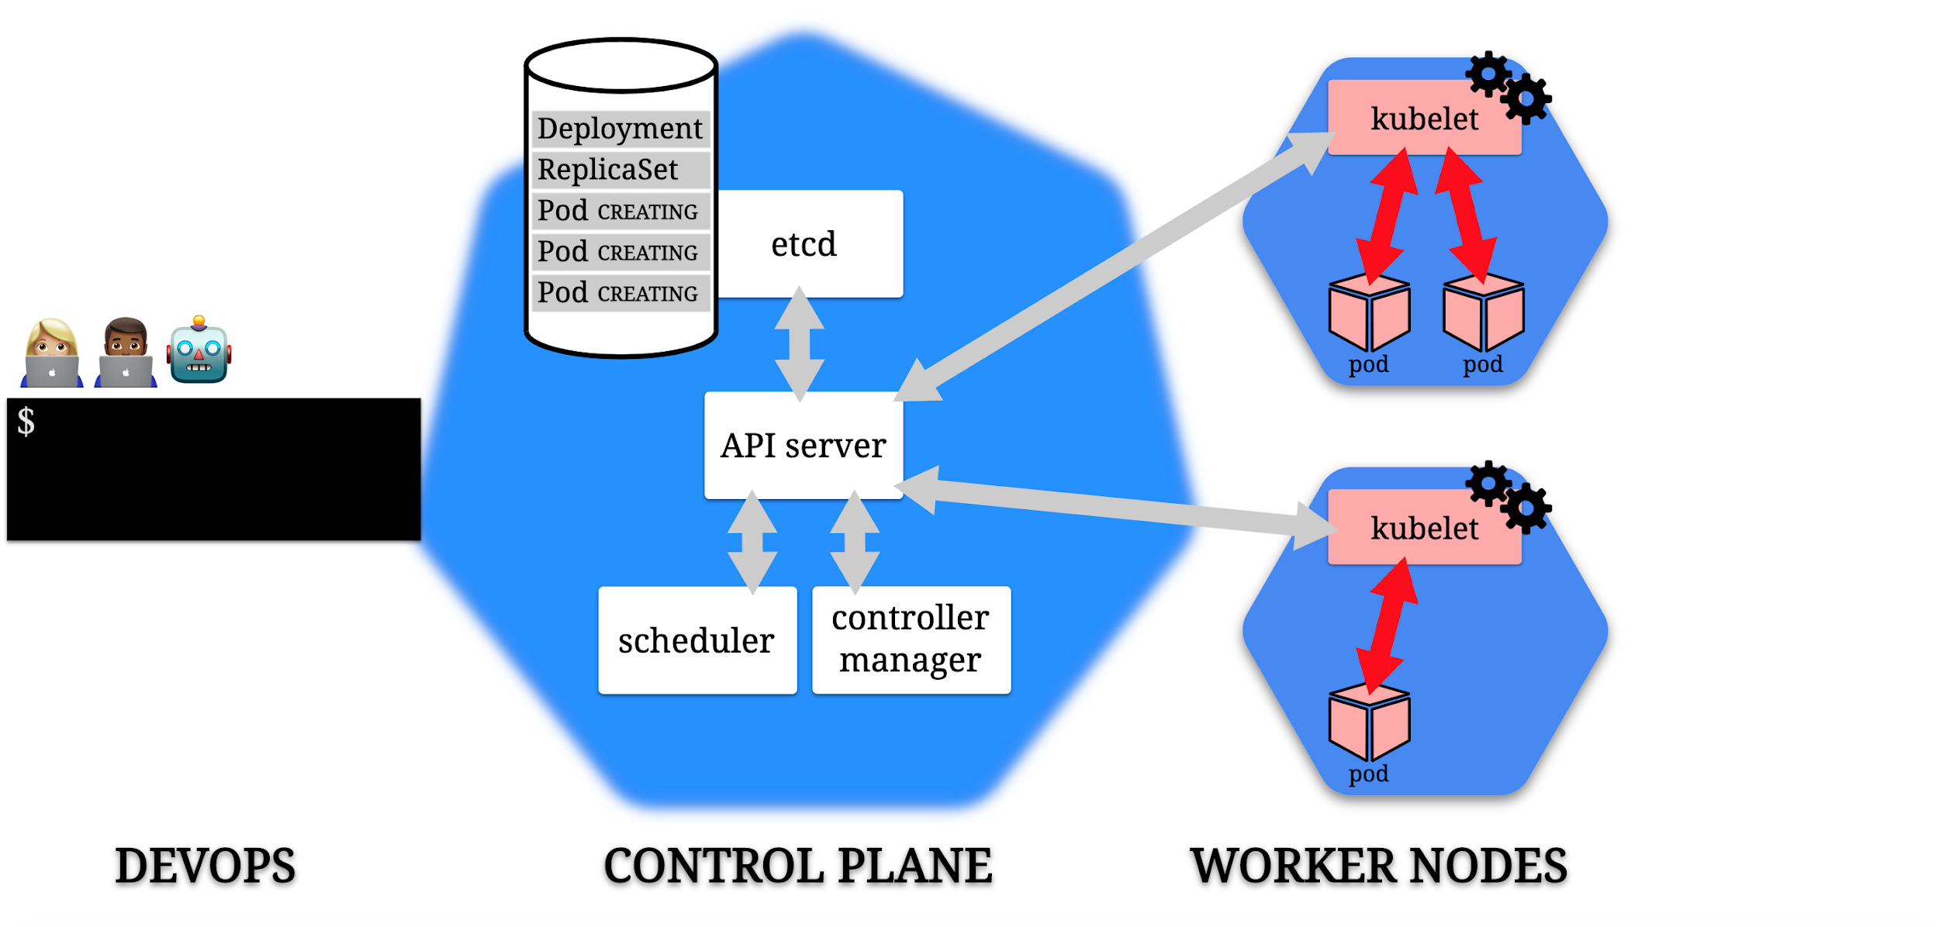

Slide 147
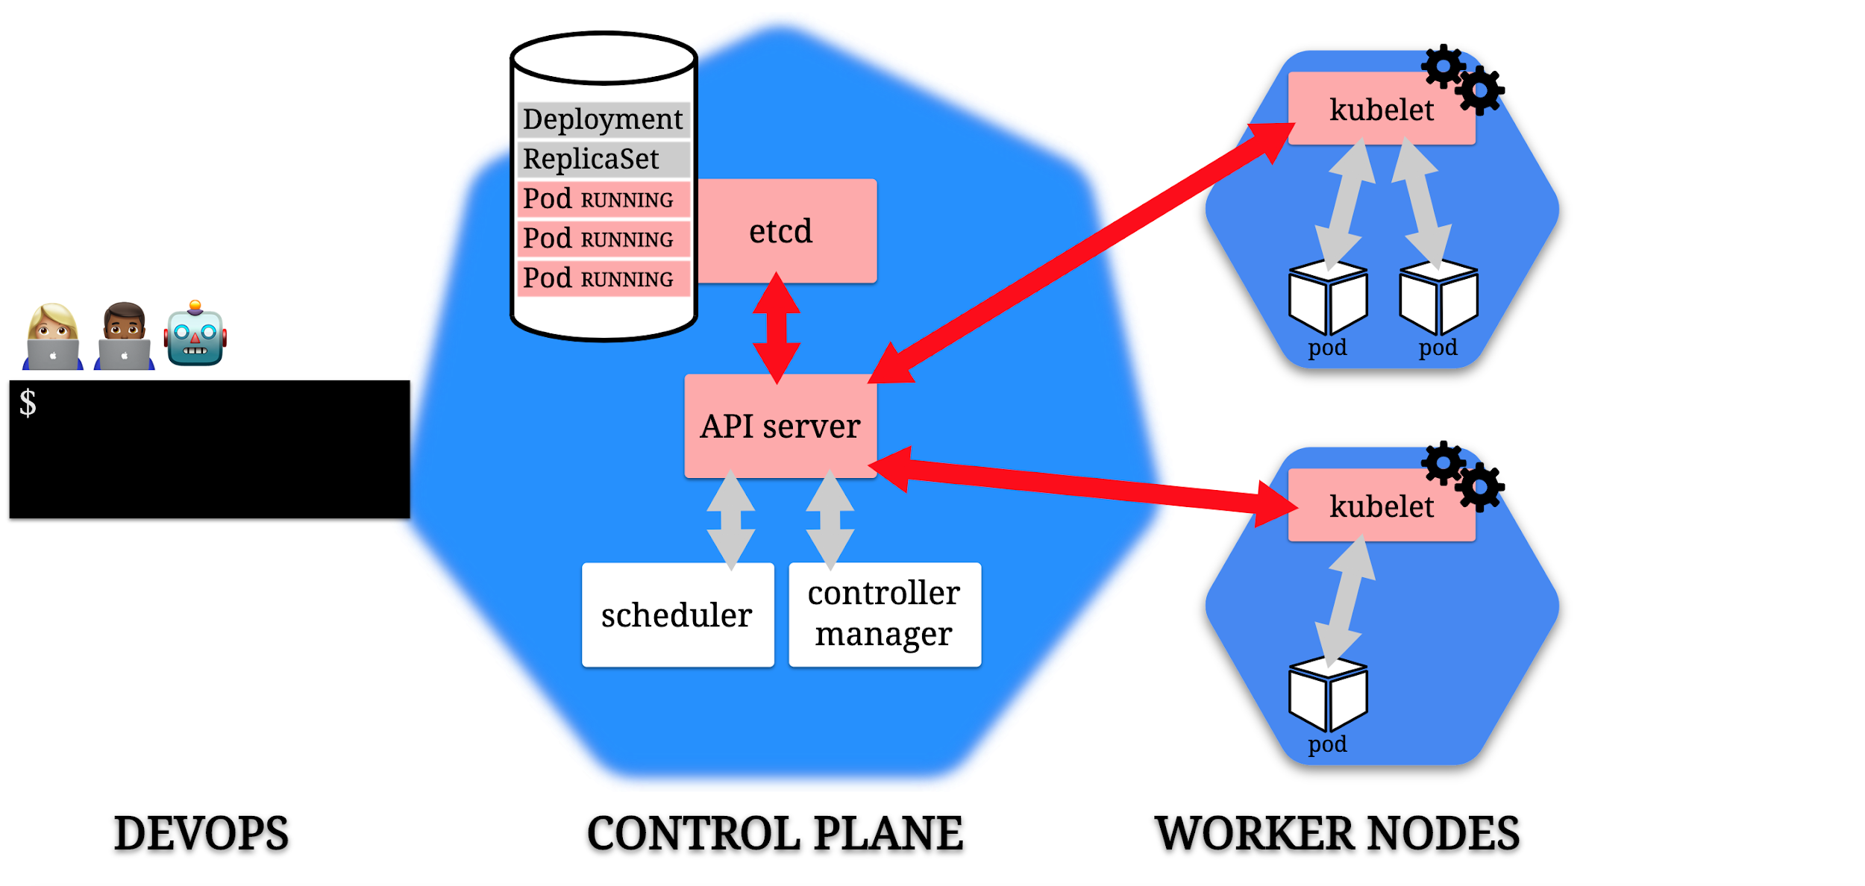

Slide 148
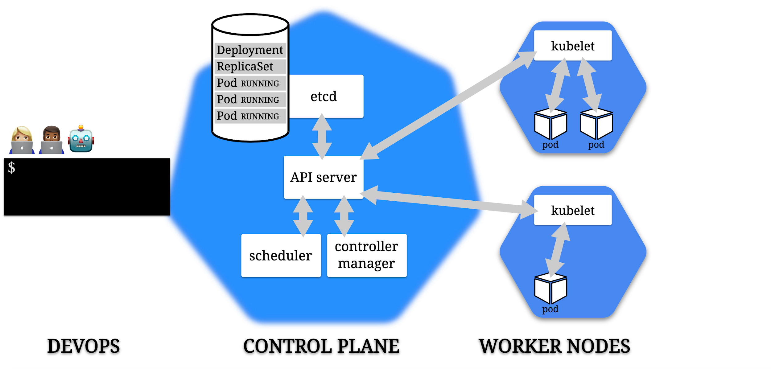

Slide 149
kubectl
kubectl (“kube-cuttle”) is command-line tool used to interact with API
May require installation (automatic if using k8s via Docker Desktop)
Config file defines details of connection to cluster (e.g., ~/.kube/config)
Run `kubectl cluster-info` to confirm connectivity
Run `kubectl` from command-line (with arguments) to see options
NOTE: k8s in Docker Desktop should handle most of this for you
`kubectl apply –f path-to-yaml-file.yml`

Slide 150
k8s Pods: The Basic Building Block
A pod represents a set of running containers in your cluster
Worker nodes host pods
The control plane manages the worker nodes and the pods inside them

Slide 151
k8s Pods: The Basic Building Block
Pod is the basic execution and scaling unit in Kubernetes
Kubernetes runs containers but always inside pods
It is like a sandbox in which containers run (abstraction)
A pod is a group of containers:
Running together (on the same node)
Sharing resources (RAM, CPU; but, also, network, volumes, etc…)
A Pod models an application-specific “logical host”

Slide 152
Pod state
Pods are considered to be relatively ephemeral (rather than durable) entities
Pods do not hold state, so if a pod crashes, Kubernetes will replace it with another
Multiple instances of the same pod are called replicas

Slide 153
Deployments
A Deployment controller provides declarative updates for Pods and ReplicaSets
The Deployment Object gives us a better way of handling the scaling of pods
The advantage of using Deployment versus using a replicaset is having rolling updates support for the pod container versions out-of-the-box

Slide 154
Deployments
Every time the application code changes, a new version of the application container is built, and then there is a need to update the Deployment manifest with the new version and tell K8s to apply the changes
K8s will then handle the rolling-out of this newer version, terminating pods with the old version as it spins up the new pods with the updated container
This means that at some point we will have multiple versions of the same application running at the same time

Slide 155
Namespaces in k8s
Provide a grouping mechanism in Kubernetes
Every k8s object belongs to a namespace
Every Cluster automatically includes a default namespace

Slide 156
Namespaces in k8s
Allow you create logical separation within a physical Cluster
Provide a boundary for security and resource control
Can explicitly create a namespace and deploy resources to it using namespace field in manifest or --namespace arg on kubectl
Notes:
Could be used to separate by environment, by dev, by test area, or whatever

Slide 157
Namespaces in k8s
Objects within a namespace are isolated from others
Enables creation of multiple instances of same apps with same names
Resources from one namespace can communicate with another namespace using Services
Controller only looks for matching resources in its namespace

Slide 158
ConfigMaps vs. Environment Variables
A ConfigMap is an API object that lets you store configuration for other objects to use
These are key/value pairs
This lets you decouple environment-specific config data from your container images, making your apps more portable
CAUTION: ConfigMaps do not provide encryption or secrecy. Use a Kubernetes Secret for that.

Slide 159
ConfigMaps
Can be:
Set of key-value pairs
Blurb of text
Binary files
One pod can use many ConfigMaps and one ConfigMap can be used by many pods
Data is read-only – pod can’t alter

Slide 160
ConfigMaps as Env Vars
Can be created from a literal:
`kubectl create configmap <name> --from-literal=<key>=<value>`
Can be created from a file (to group together multiple settings):
`kubectl create configmap <name> --from-env-file=<file-path>`
Where <file-path> contains .env file like:
key1=value1
key2=value2
Can be created from a .yml definition file (like all things k8s)

Slide 161
ConfigMaps
Can be presented as files inside directories in the container
Uses volumes – making contents of ConfigMap available to pod
Uses volume mounts – loads contents of ConfigMap volume into specific container path in pod
Can contain settings to override defaults

Slide 162
ConfigMaps - Precedence
If env vars defined in multiple places, definitions in `env` section in pod spec will trump others (localized)
Typical approach:
Default app settings “baked in” to container image (e.g., to support dev mode)
Specific settings for an environment stored in ConfigMap and surfaced to container filesystem
Merges with default settings (overwriting where applicable)
Final tweaks can be accomplished with env variables in pod spec

Slide 163
Secrets in Pods
Secrets let you store and manage sensitive information, such as passwords, OAuth tokens, and ssh keys.
A pod needs to reference a secret. There are three ways get to the secret:
As a file in a Volume that is mounted to a container;
As an environment variable for a container;
By the kubelet, when it pulls images for the pod
NOTE: The default config for a Secret does NOT have encryption – data is plain text. You need to configure “Encryption at Rest” for the Secret”, and Role Based Access Control in your cluster

Slide 164
k8s Services
Services are an abstraction
They define a set of pods, and an access policy for them
A pod has an IP address
Pods are ephemeral – what happens to IP traffic if they die?
Pods in a service can have fixed IP addresses that stay the same even if the actual pod dies and is spun up again
Services are k8s objects; they are created like any other

Slide 165
k8s Service Types
ClusterIP (default): IP is internal to the cluster
NodePort: IP for the port is exposed with a static IP address
LoadBalancer: IP traffic to nodes is managed by external load balancer
ExternalName: IP traffic is routed by DNS Name (foo.example.com)

Slide 166
PersistentVolume
Like pods (abstraction over computer) and services (abstraction over network), persistent volumes provide abstraction over storage
k8s object that defines available section of storage
Can be “mapped” to shared storage (like NFS) or locally (for dev/test purposes)

Slide 167
PersistentVolumeClaim
Pods are not allowed to use persistent volumes directly
Instead, pods claim using PersistentVolumeClaim object type in k8s
Requests storage for a pod
k8s handles matching up a claim to a persistent volume
Provides virtual storage abstracted from actual storage

Slide 168
Demo
Notes:
Lab04

Slide 169
Continue Lab
Notes:
Lab04

Slide 170




Thank you!
If you have additional questions, please reach out to me at:
(asanders@gamuttechnologysvcs.com)

